Slide 1
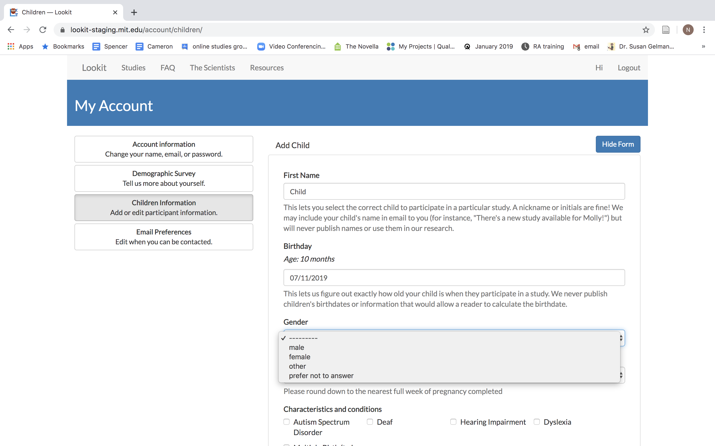
Notes:
Slides by Nicole Cuneo – please credit if reusing portions!

Slide 2
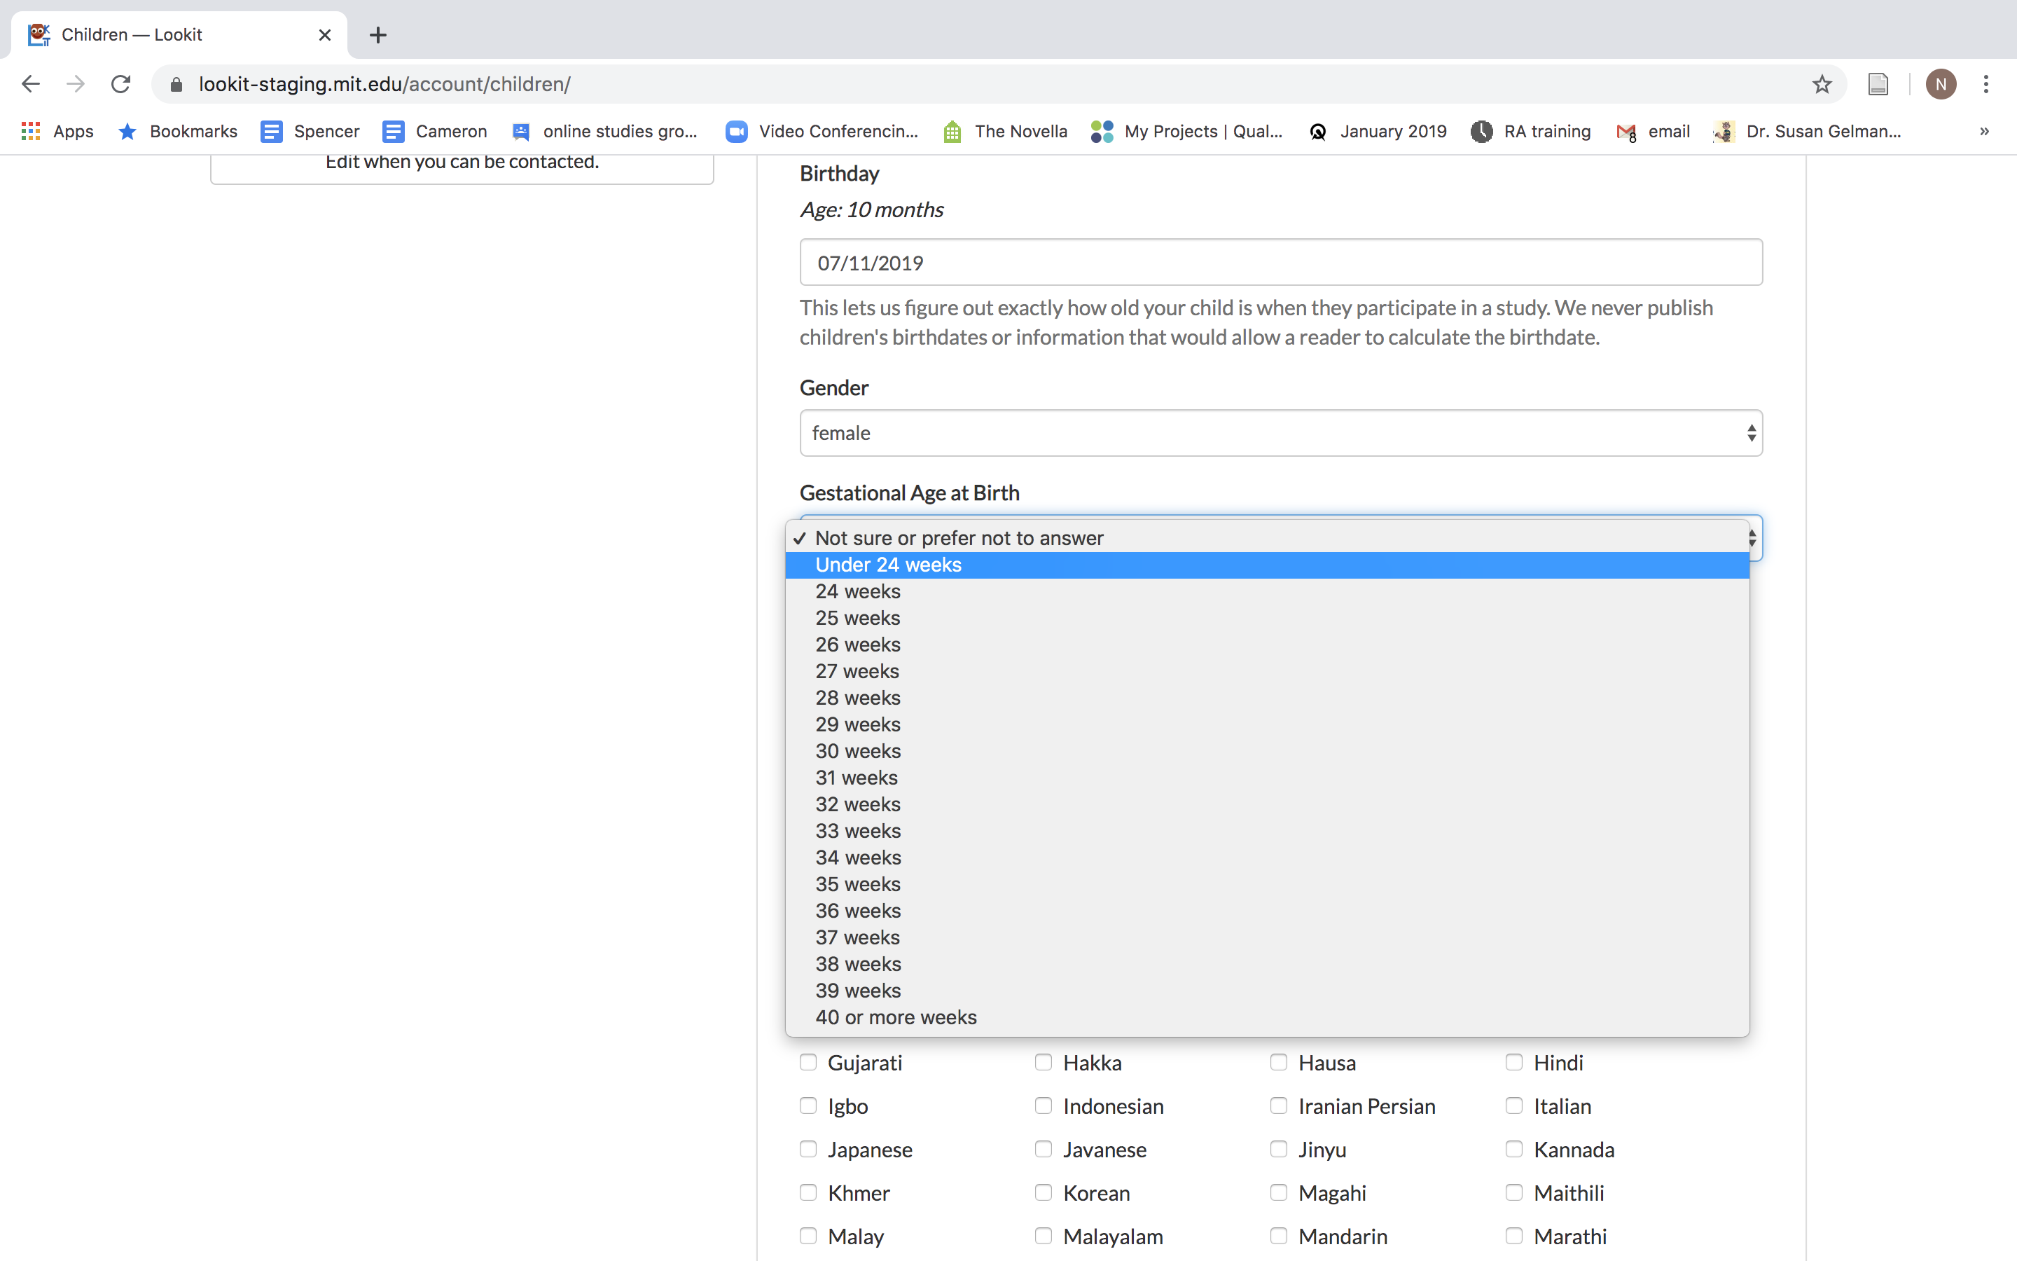
NOTE: (as per the Lookit Slack) the options on these demographic forms may change
**feedback: some options can be better, parents don’t love these options, all of these options may not be necessary

Slide 3
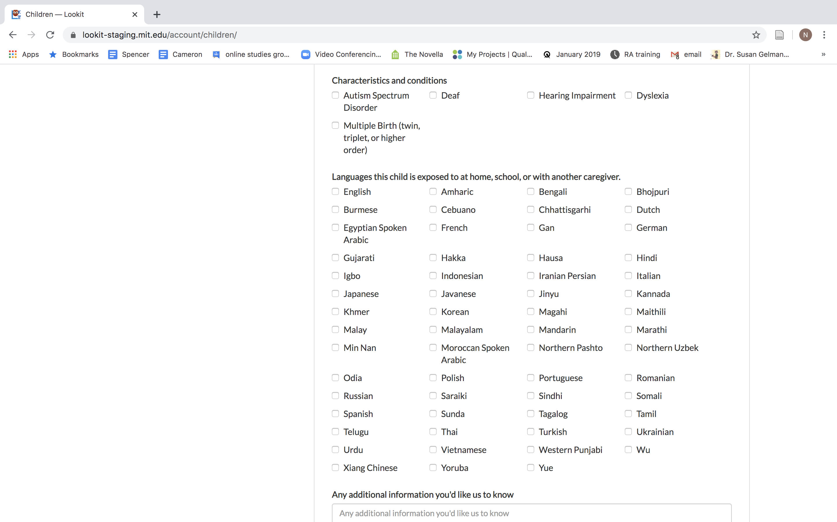
NOTE: (as per the Lookit Slack) the options on these demographic forms may change
**feedback: some options can be better, parents don’t love these options, all of these options may not be necessary

Slide 4
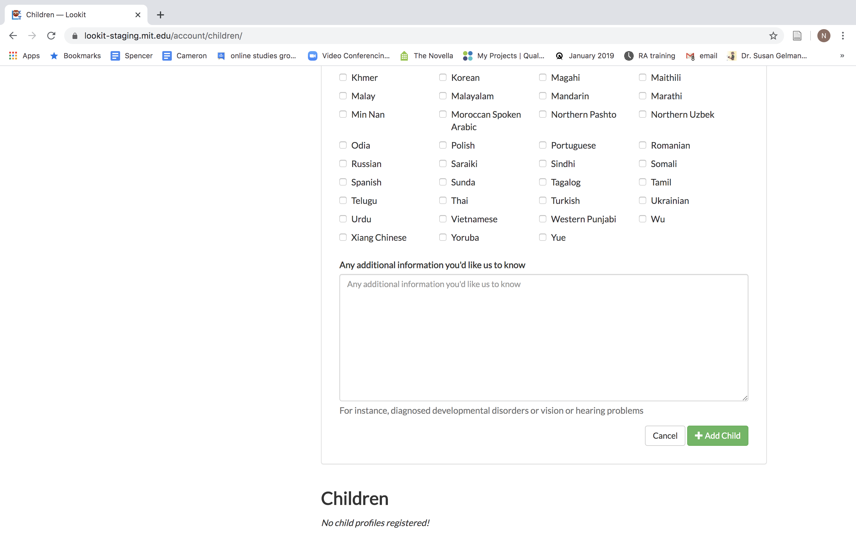
NOTE: (as per the Lookit Slack) the options on these demographic forms may change
**feedback: some options can be better, parents don’t love these options, all of these options may not be necessary

Slide 5
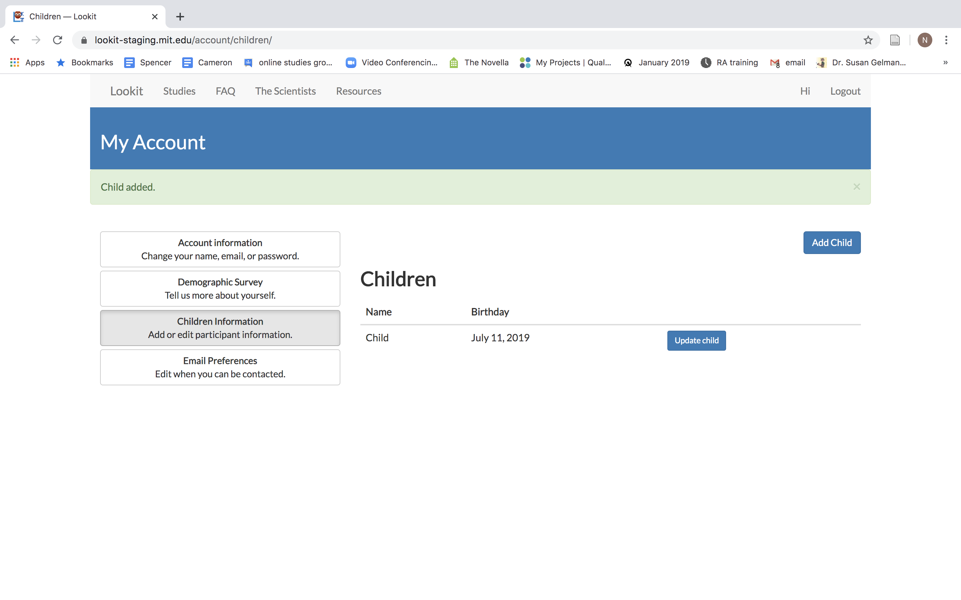
Can include as many children as you want
Can update (especially important for- diagnosis changes/language changes, etc…)

Slide 6
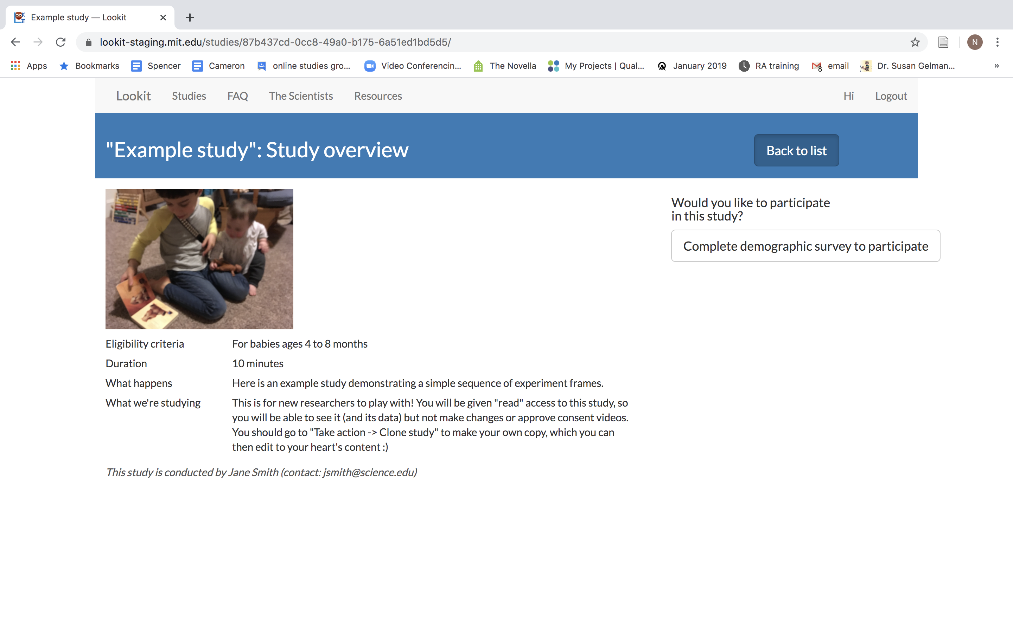
-Can’t participate in surveys without your demographics survey on your account (I tried!)
-it gives you this error

Slide 7
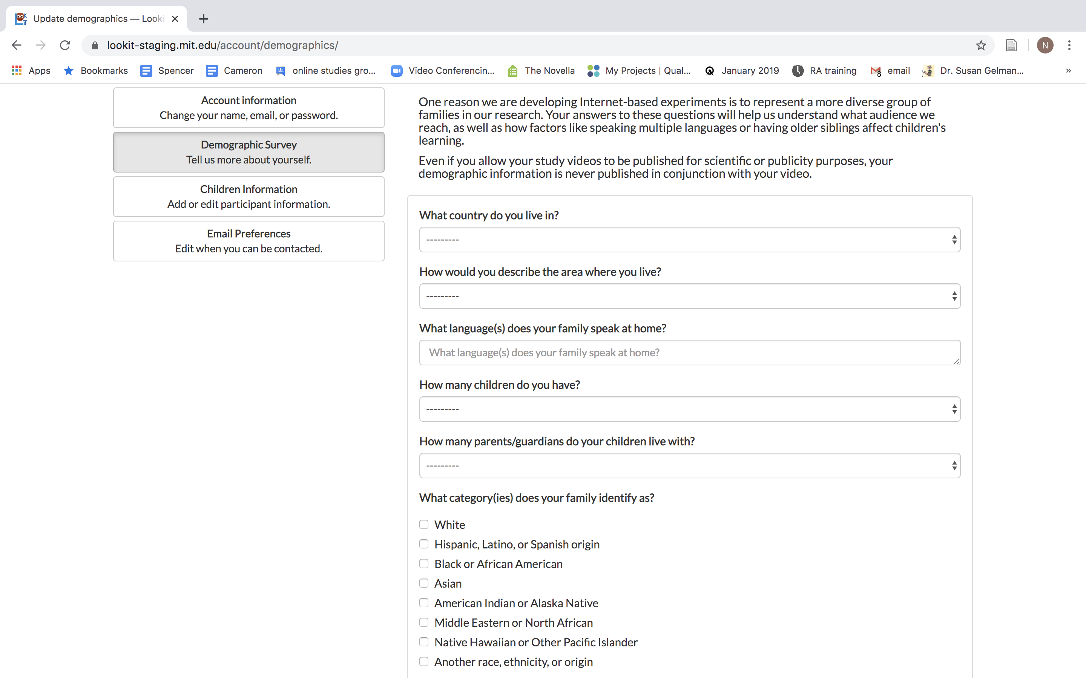

Slide 8
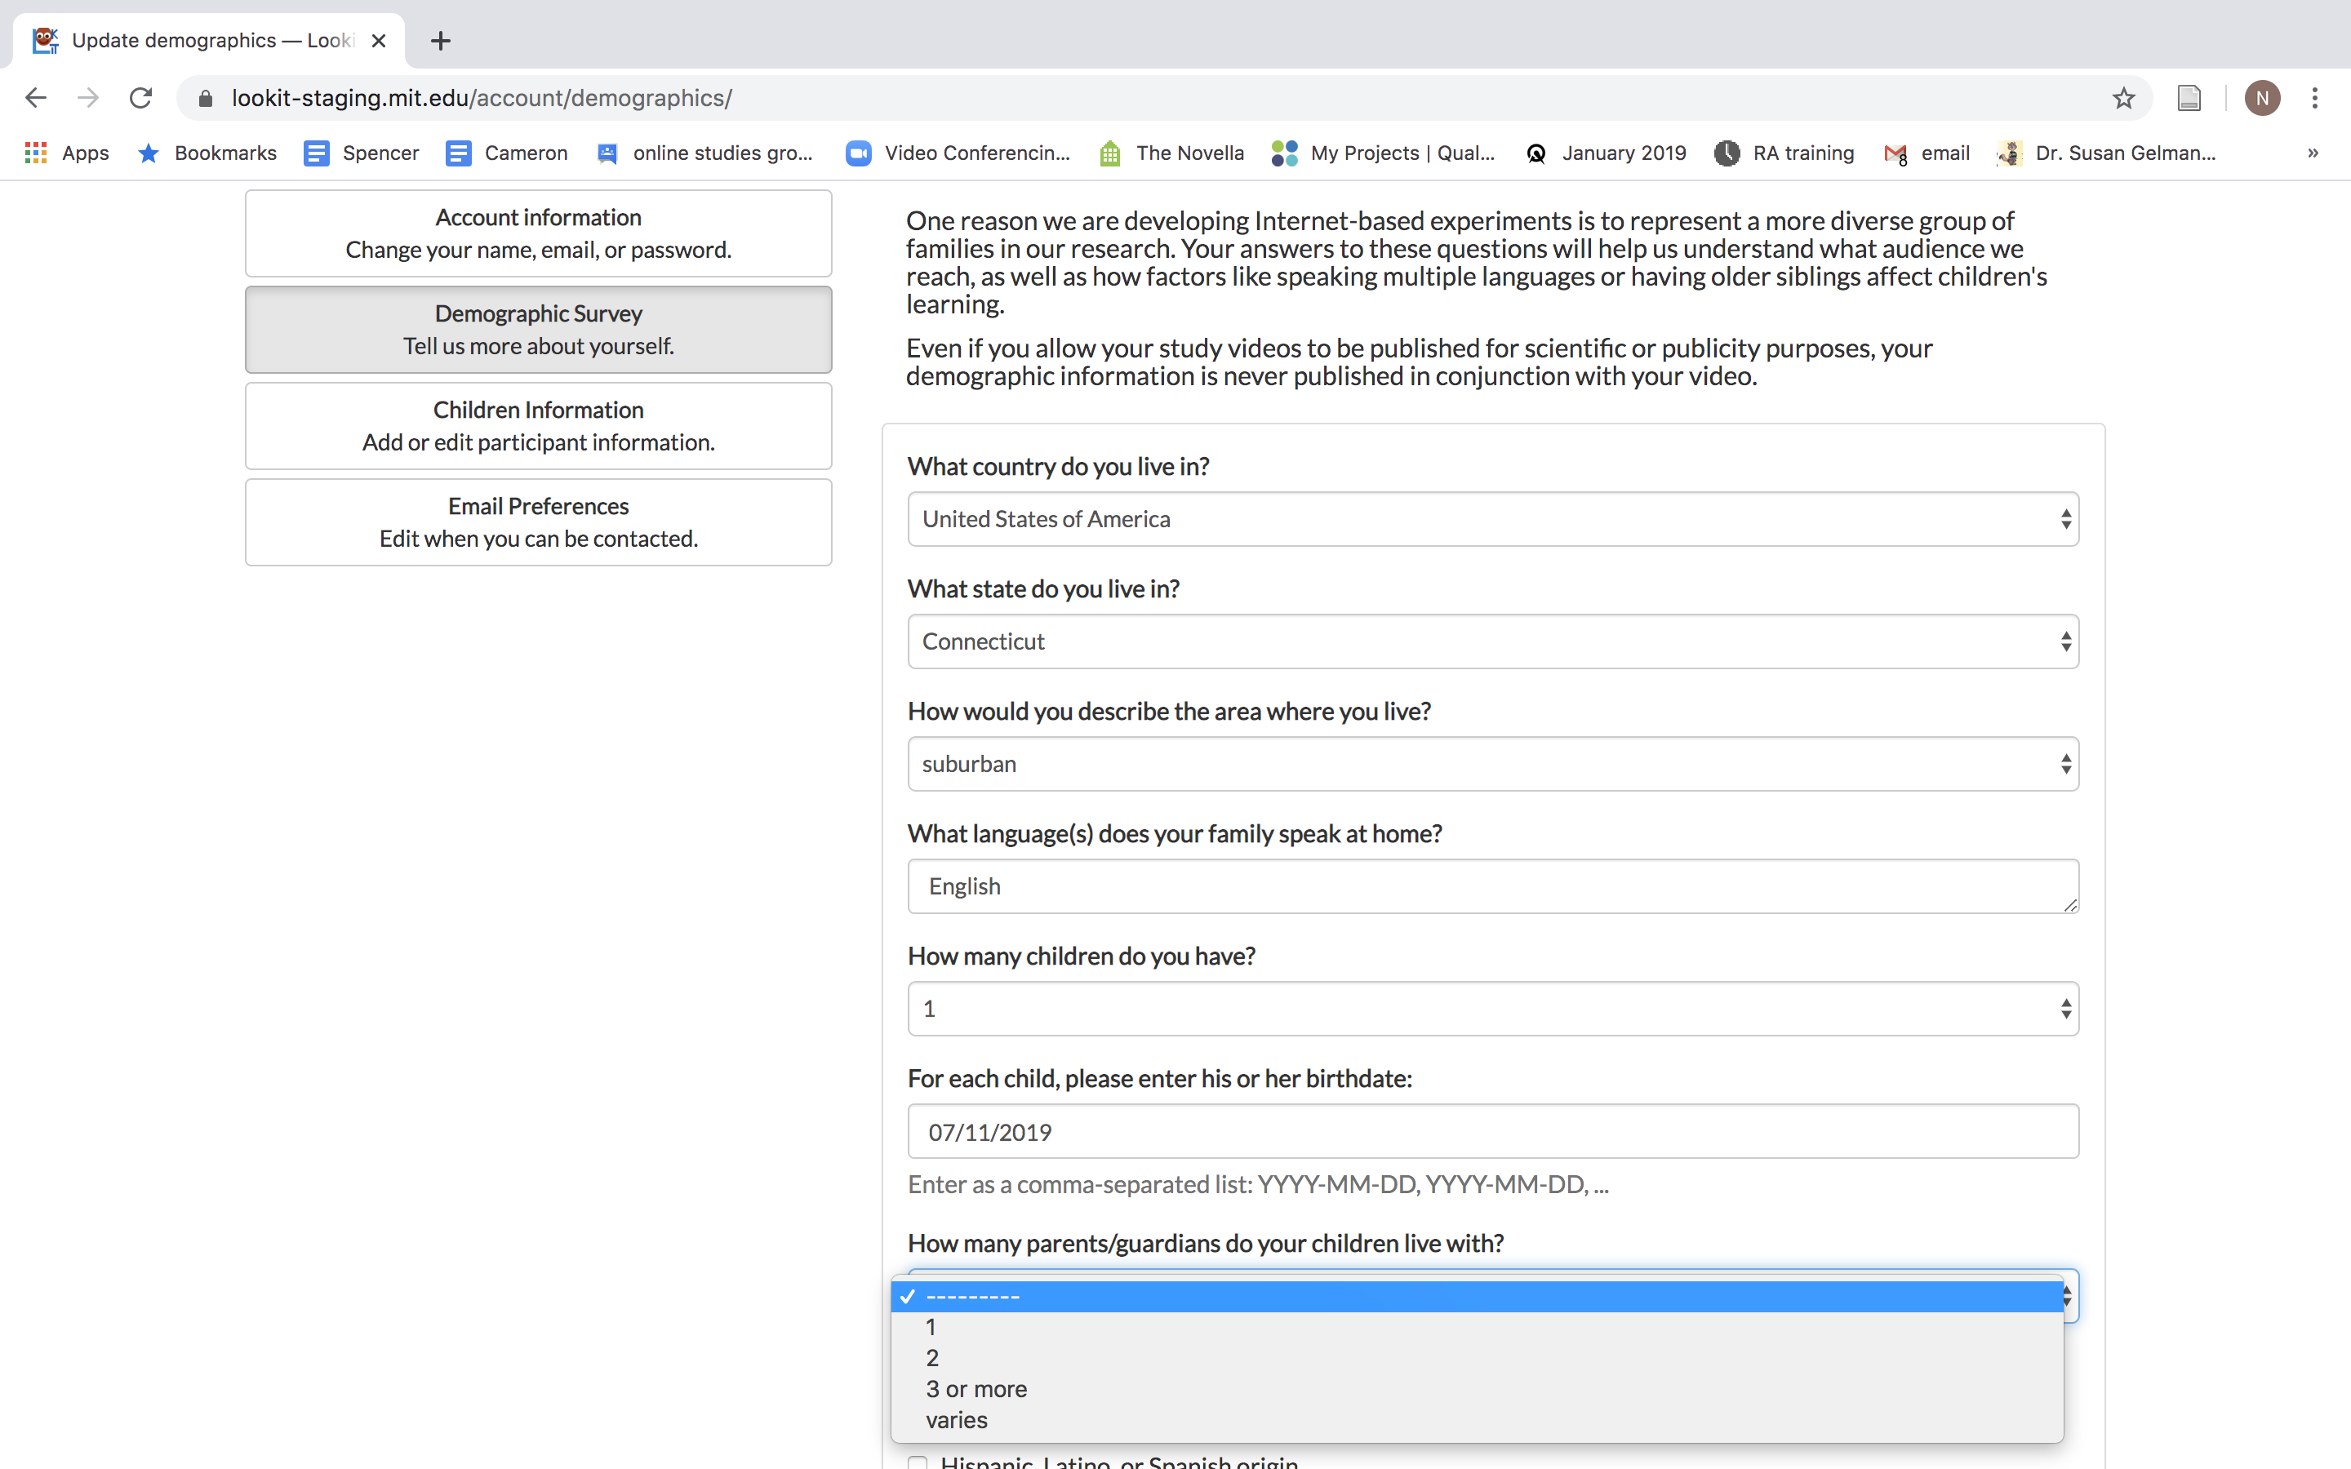

Slide 9
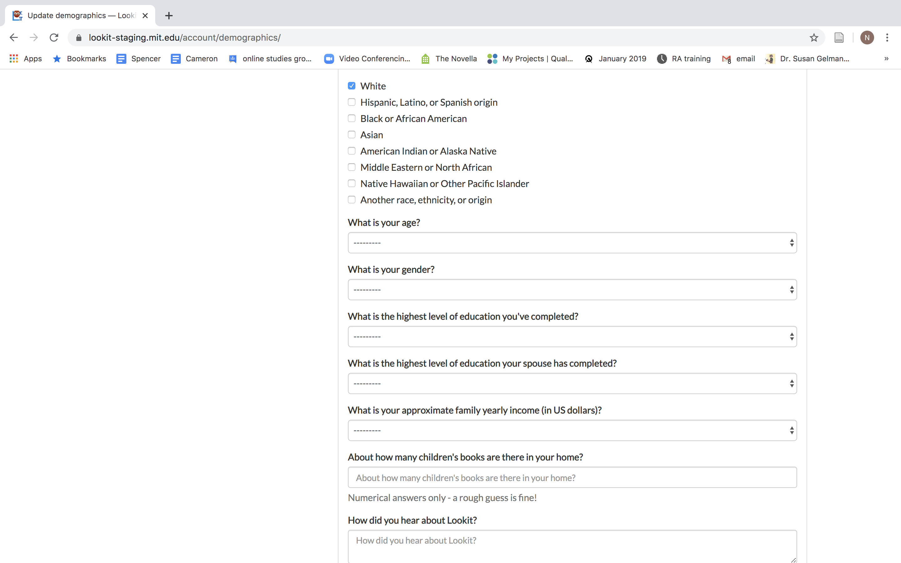
NOTE: (as per the Lookit Slack) the options on these demographic forms may change
**feedback: some options can be better, parents don’t love these options, all of these options may not be necessary

Slide 10
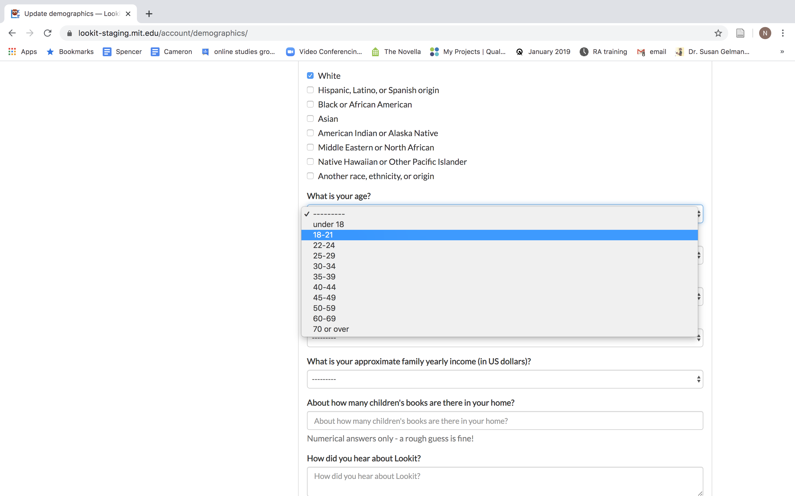
NOTE: (as per the Lookit Slack) the options on these demographic forms may change
**feedback: some options can be better, parents don’t love these options, all of these options may not be necessary

Slide 11
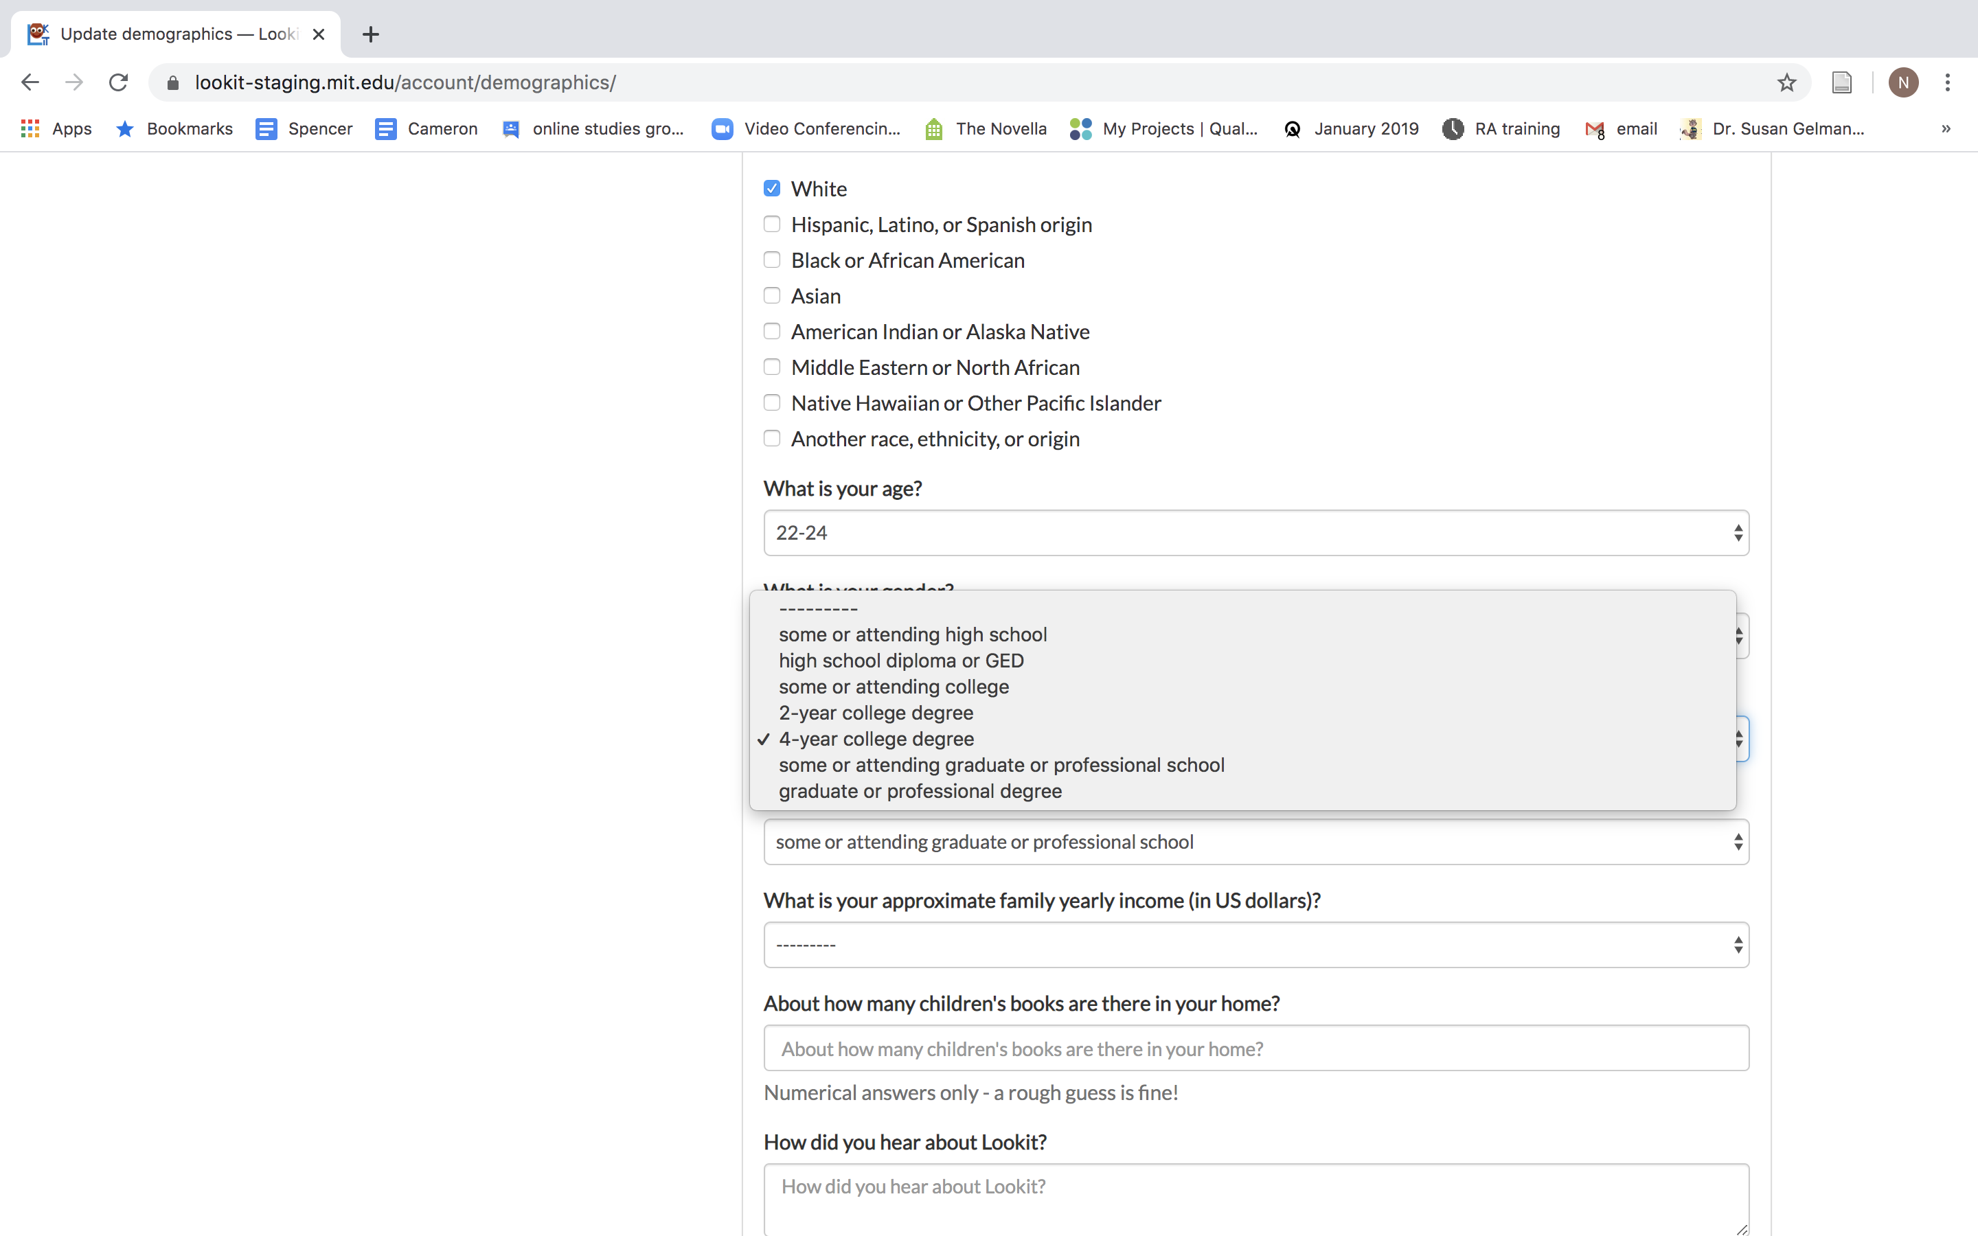
NOTE: (as per the Lookit Slack) the options on these demographic forms may change
**feedback: some options can be better, parents don’t love these options, all of these options may not be necessary

Slide 12
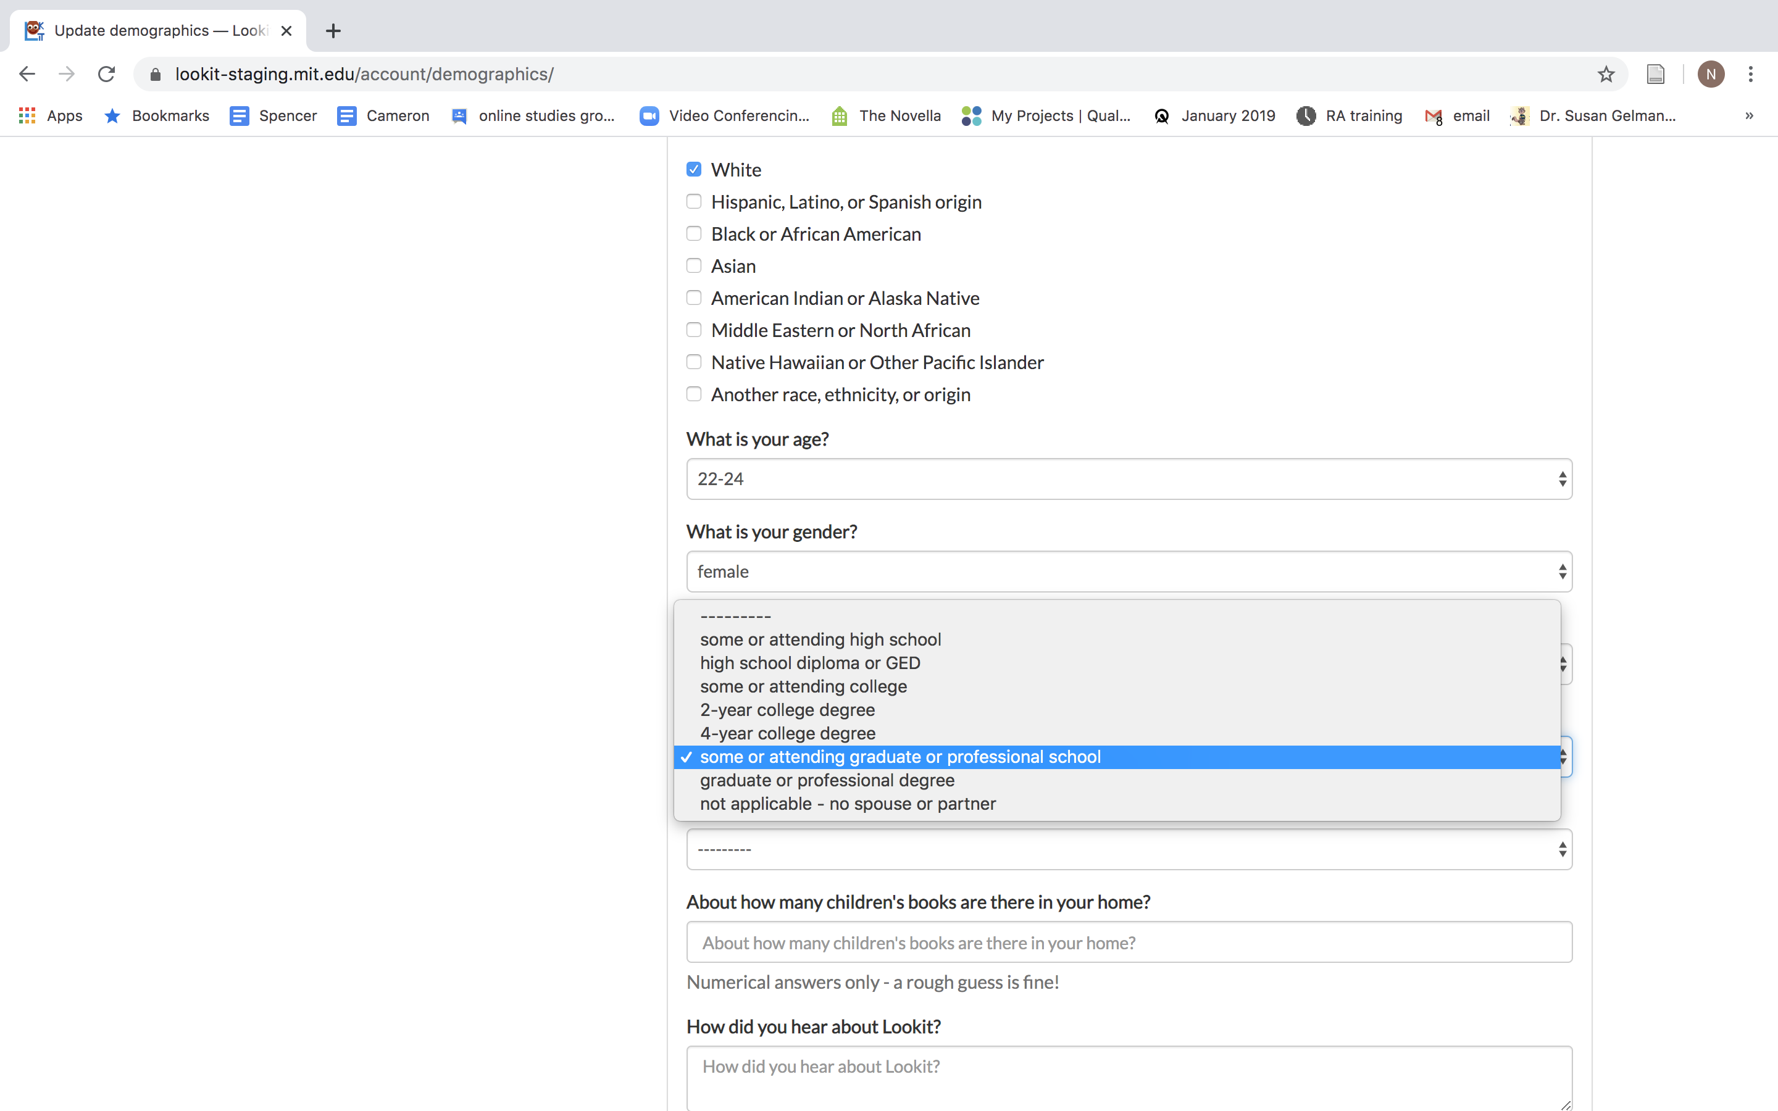
NOTE: (as per the Lookit Slack) the options on these demographic forms may change
**feedback: some options can be better, parents don’t love these options, all of these options may not be necessary

Slide 13
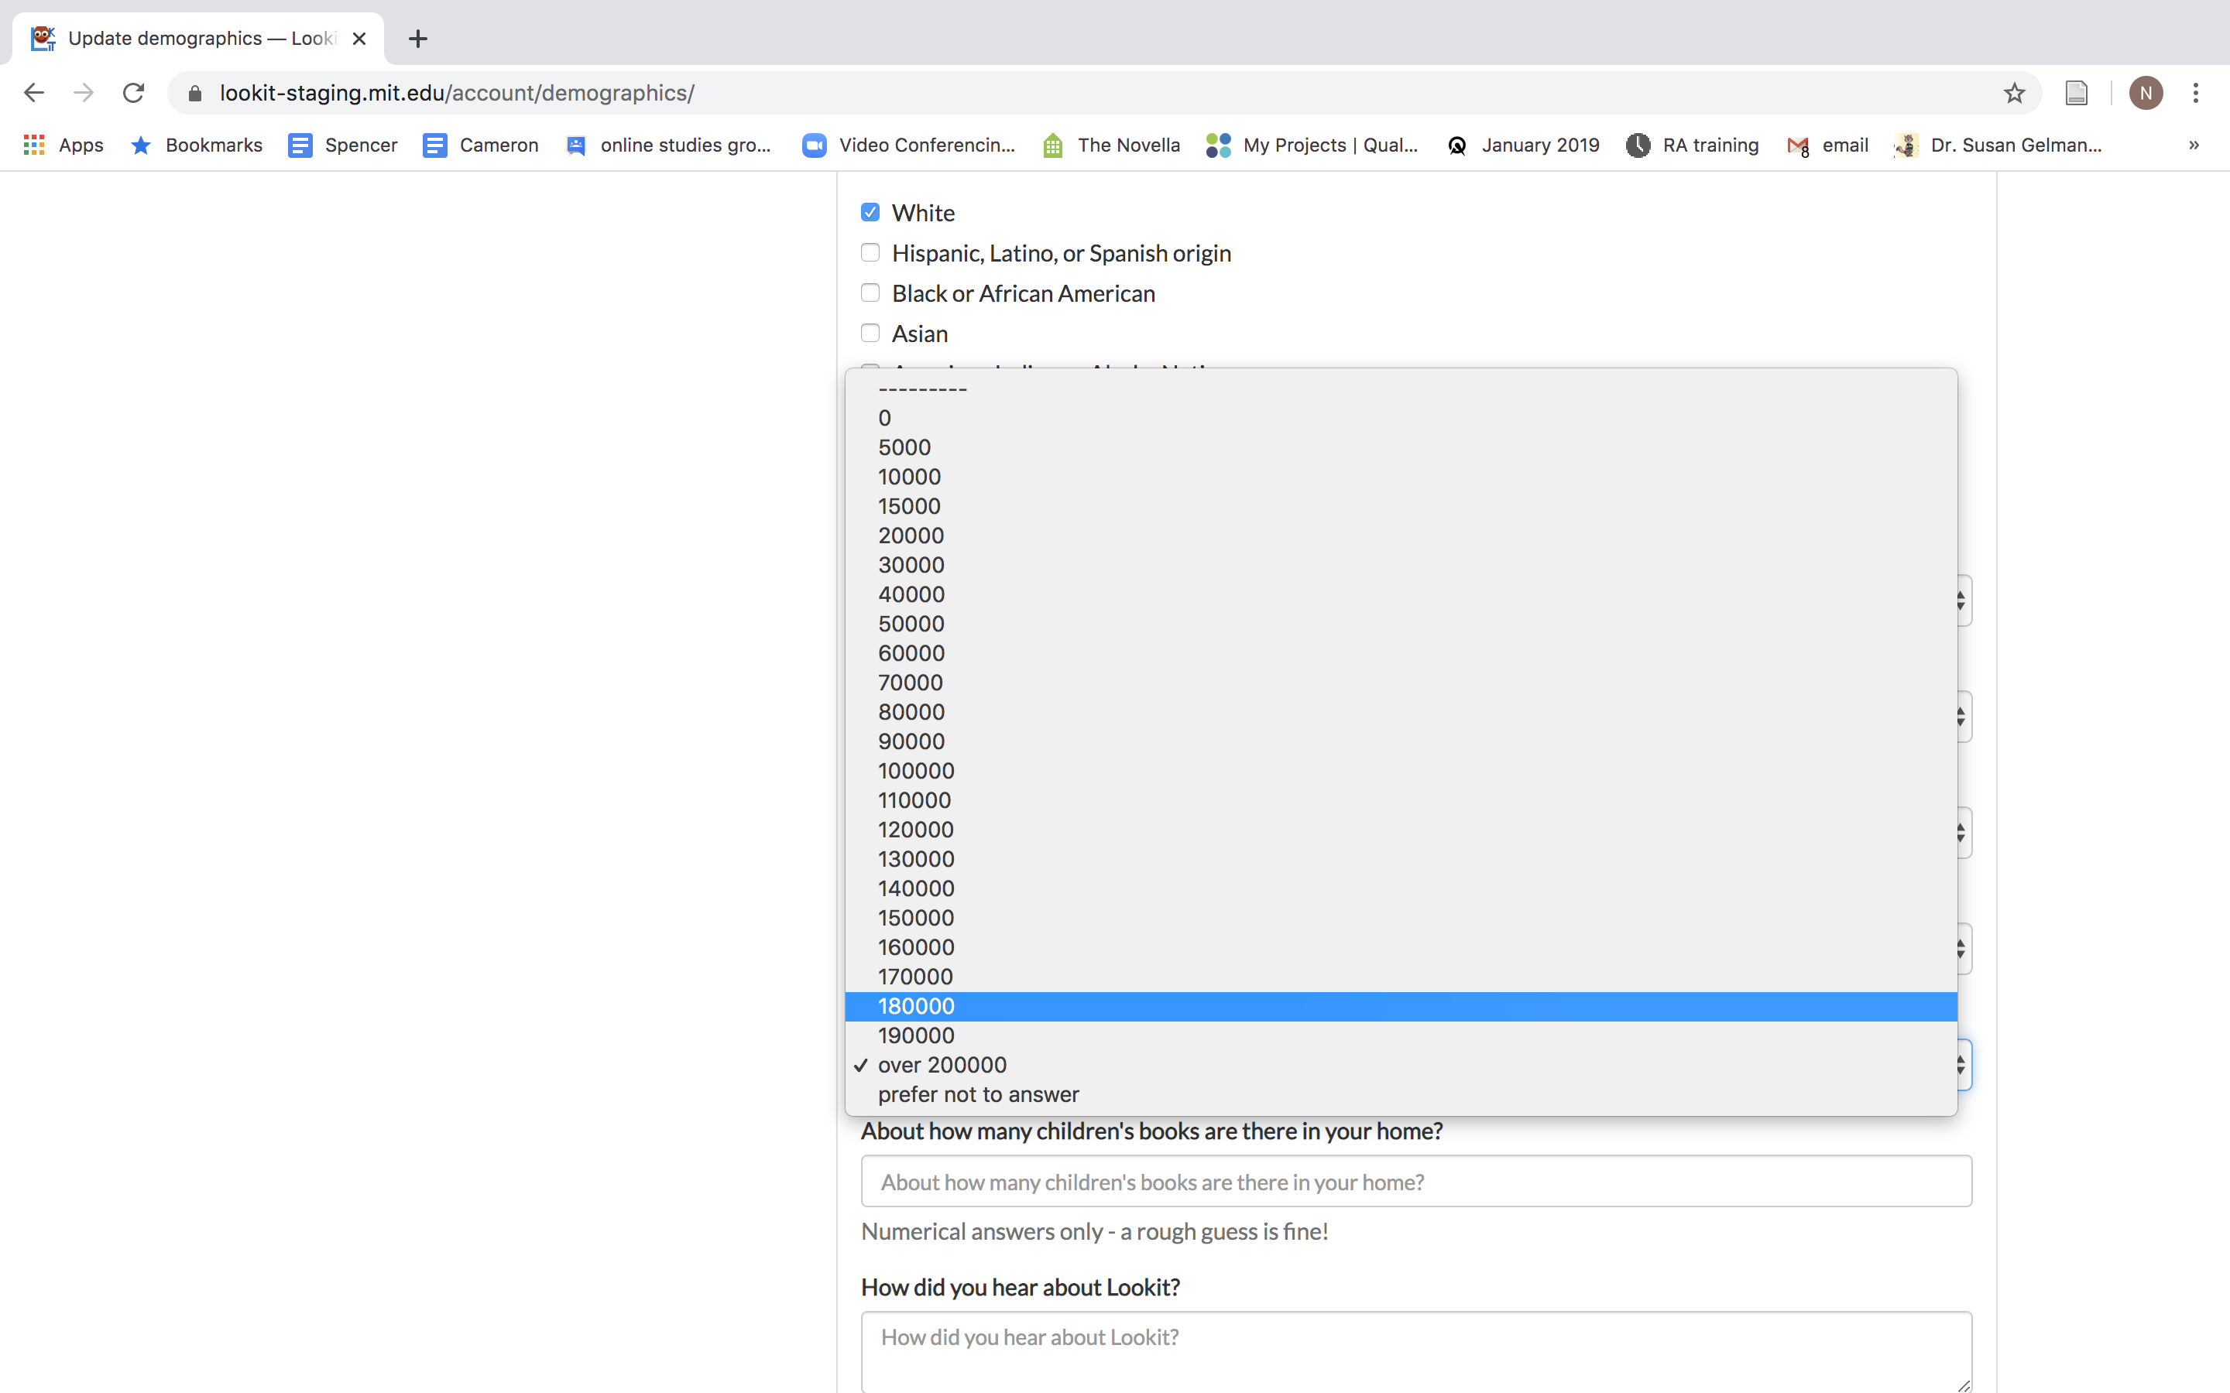
NOTE: (as per the Lookit Slack) the options on these demographic forms may change
**feedback: some options can be better, parents don’t love these options, all of these options may not be necessary

Slide 14
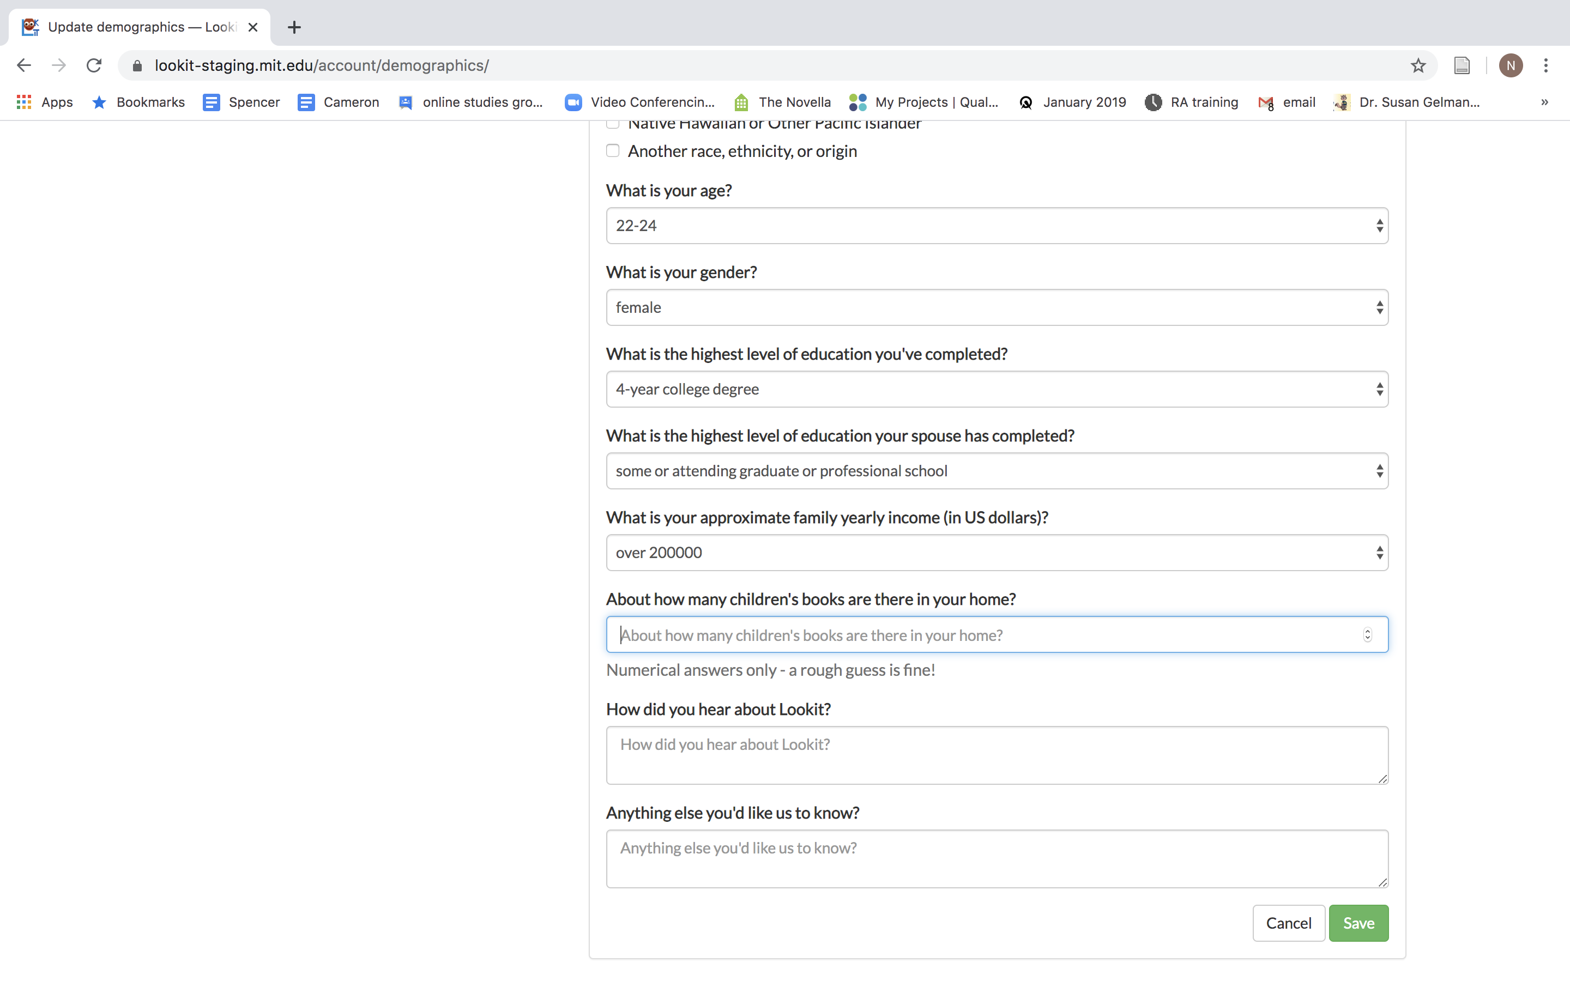
NOTE: (as per the Lookit Slack) the options on these demographic forms may change
**feedback: some options can be better, parents don’t love these options, all of these options may not be necessary

Slide 15
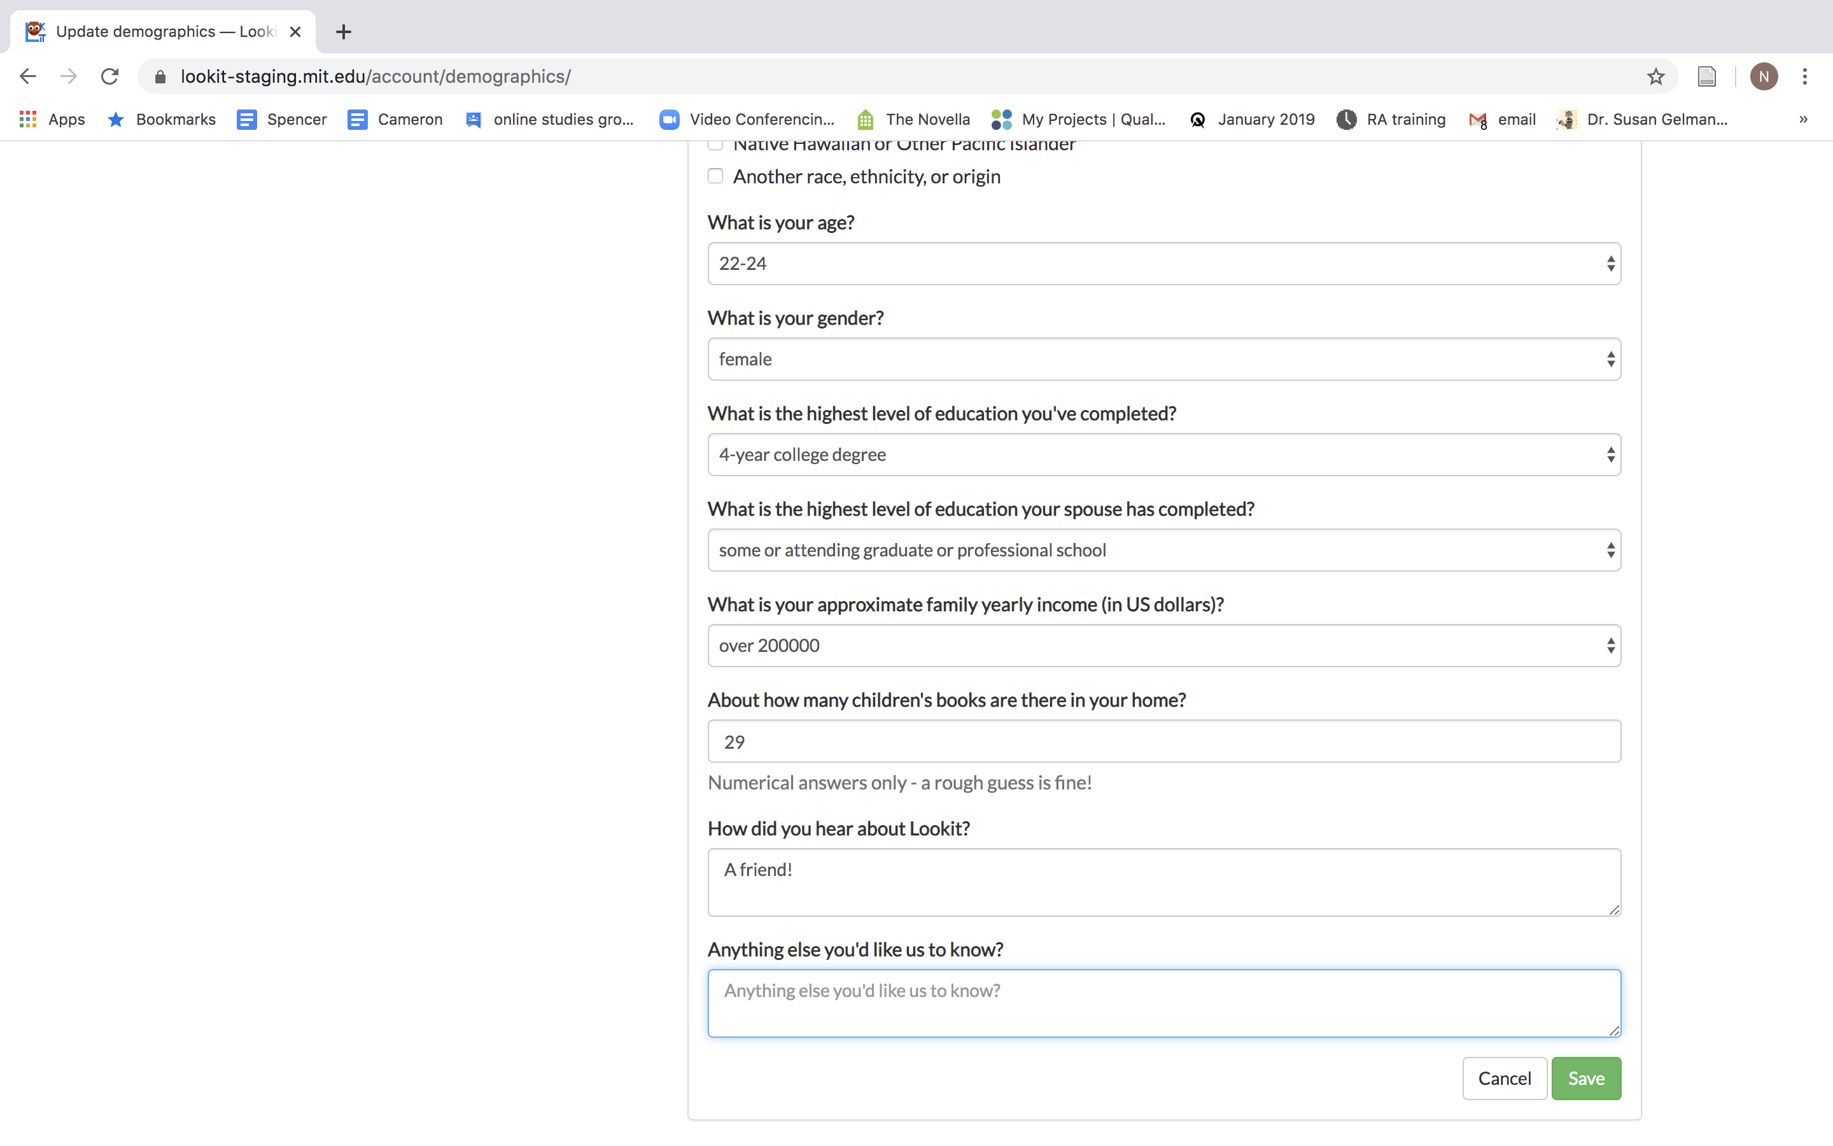
NOTE: (as per the Lookit Slack) the options on these demographic forms may change
**feedback: some options can be better, parents don’t love these options, all of these options may not be necessary

Slide 16
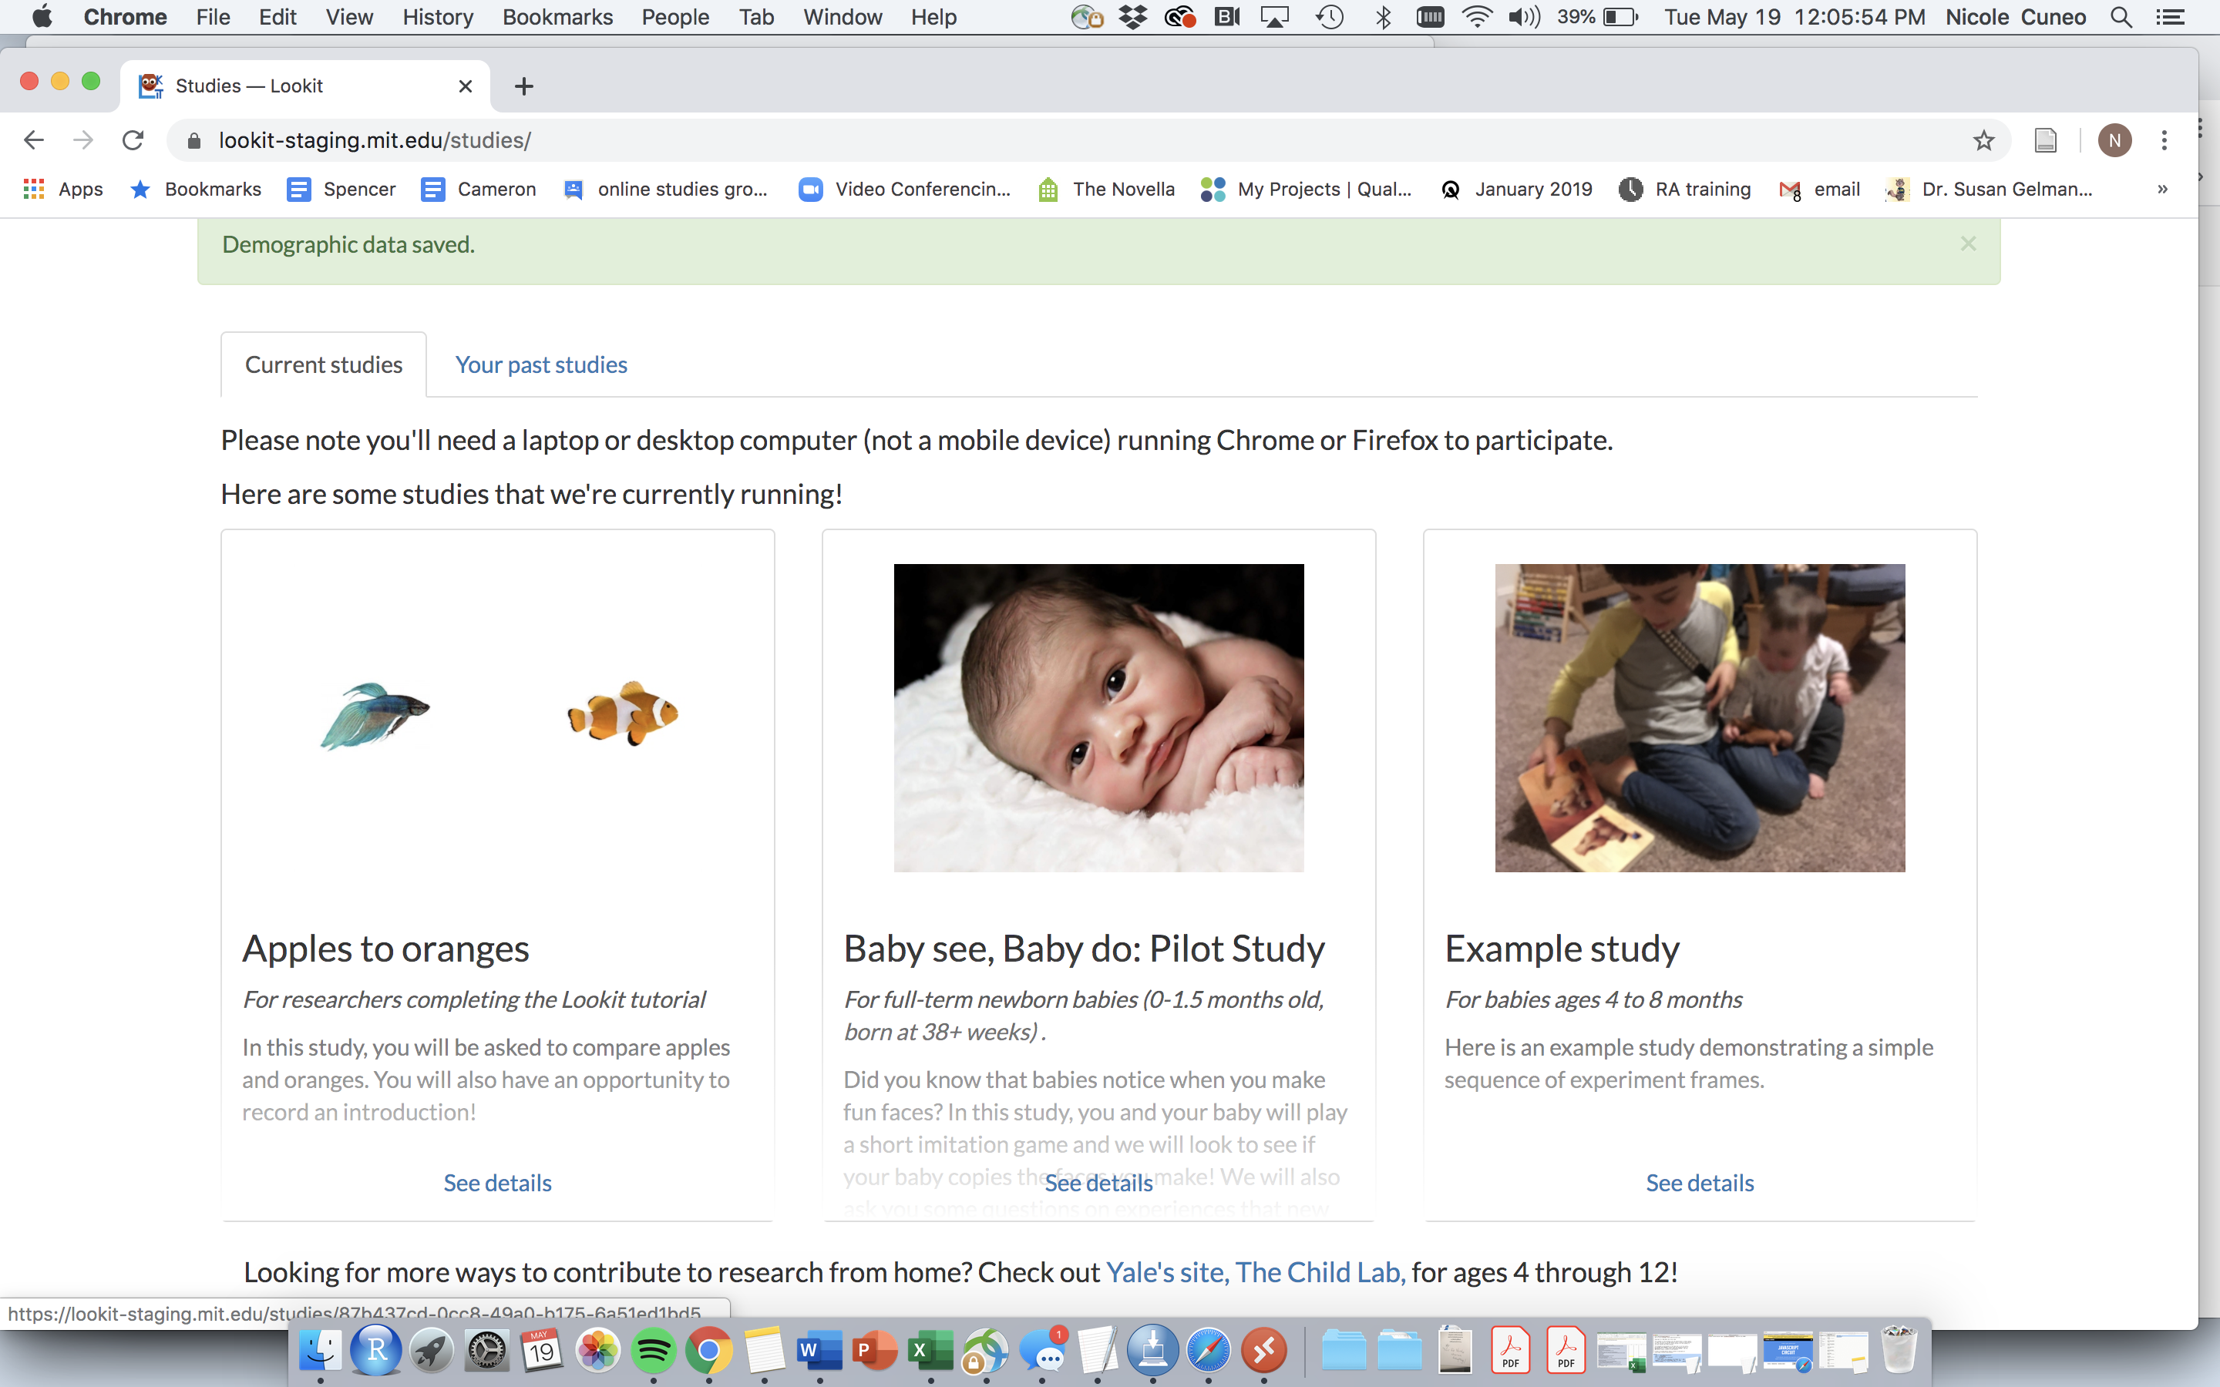
Sample Study Page!

Slide 17
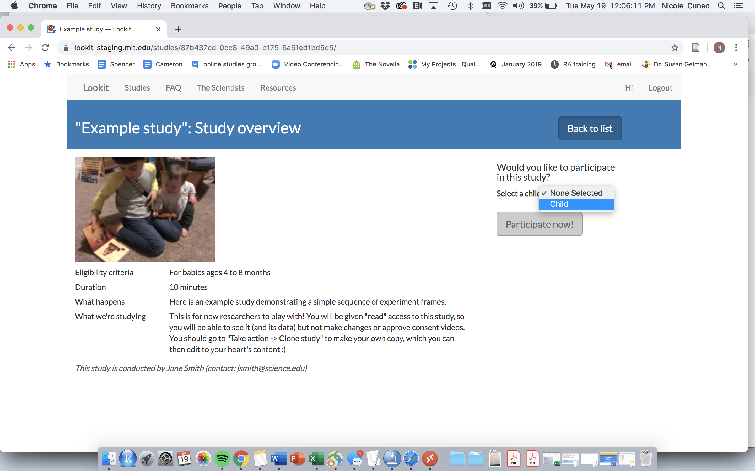
Must select which child you want to participate
At the end of the study, the parent has to re-enter the birth date of the child

Slide 18
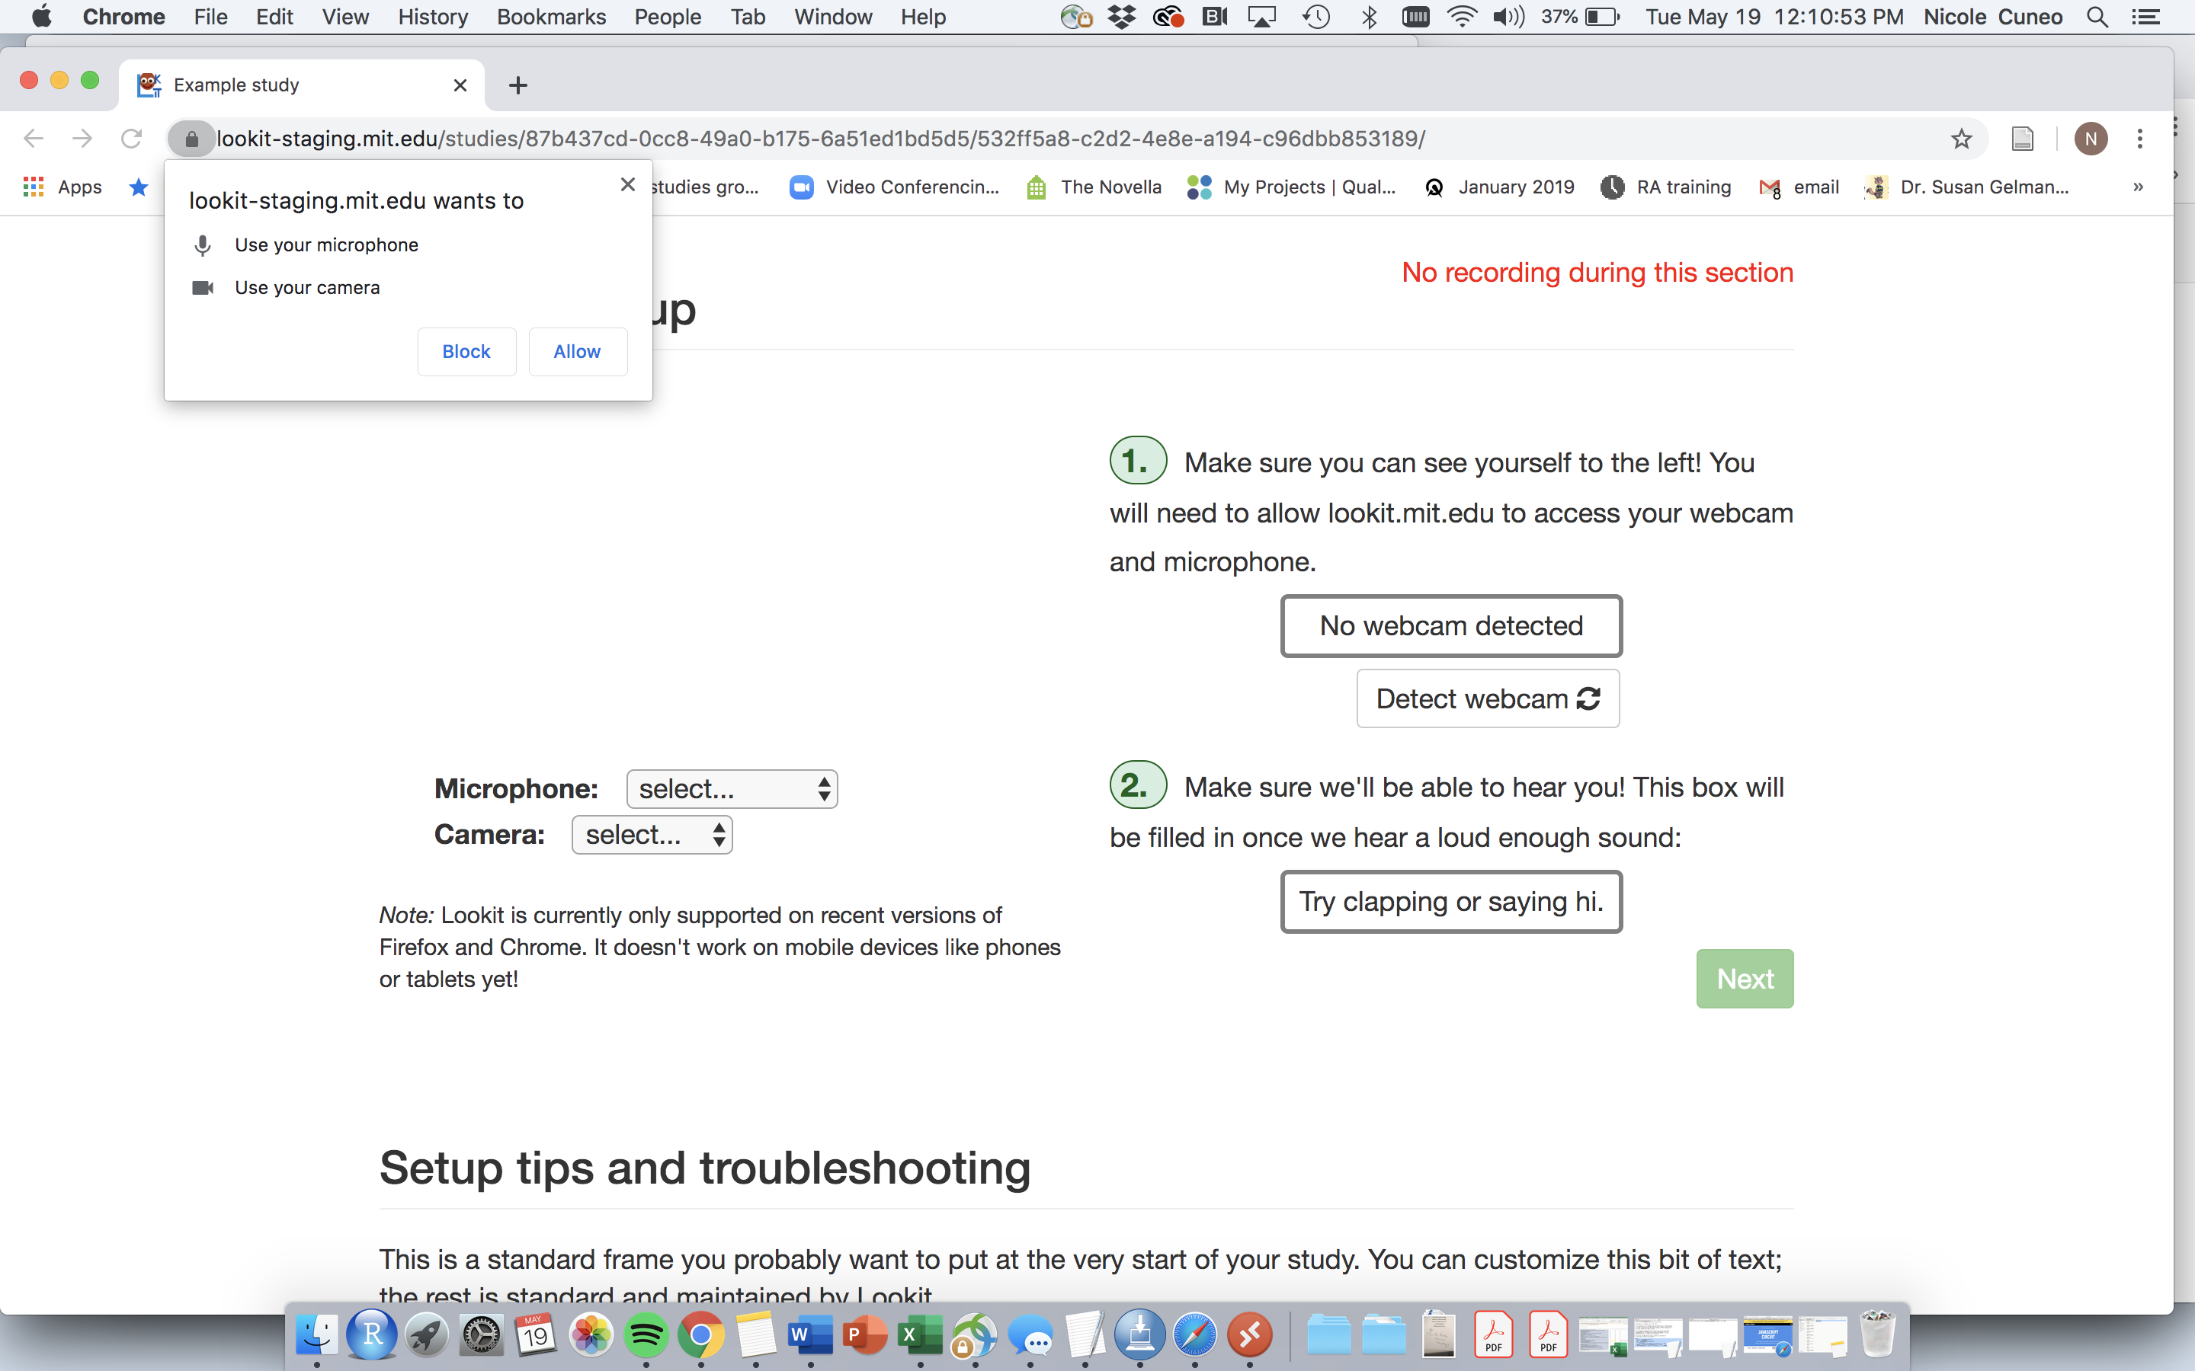

Slide 19
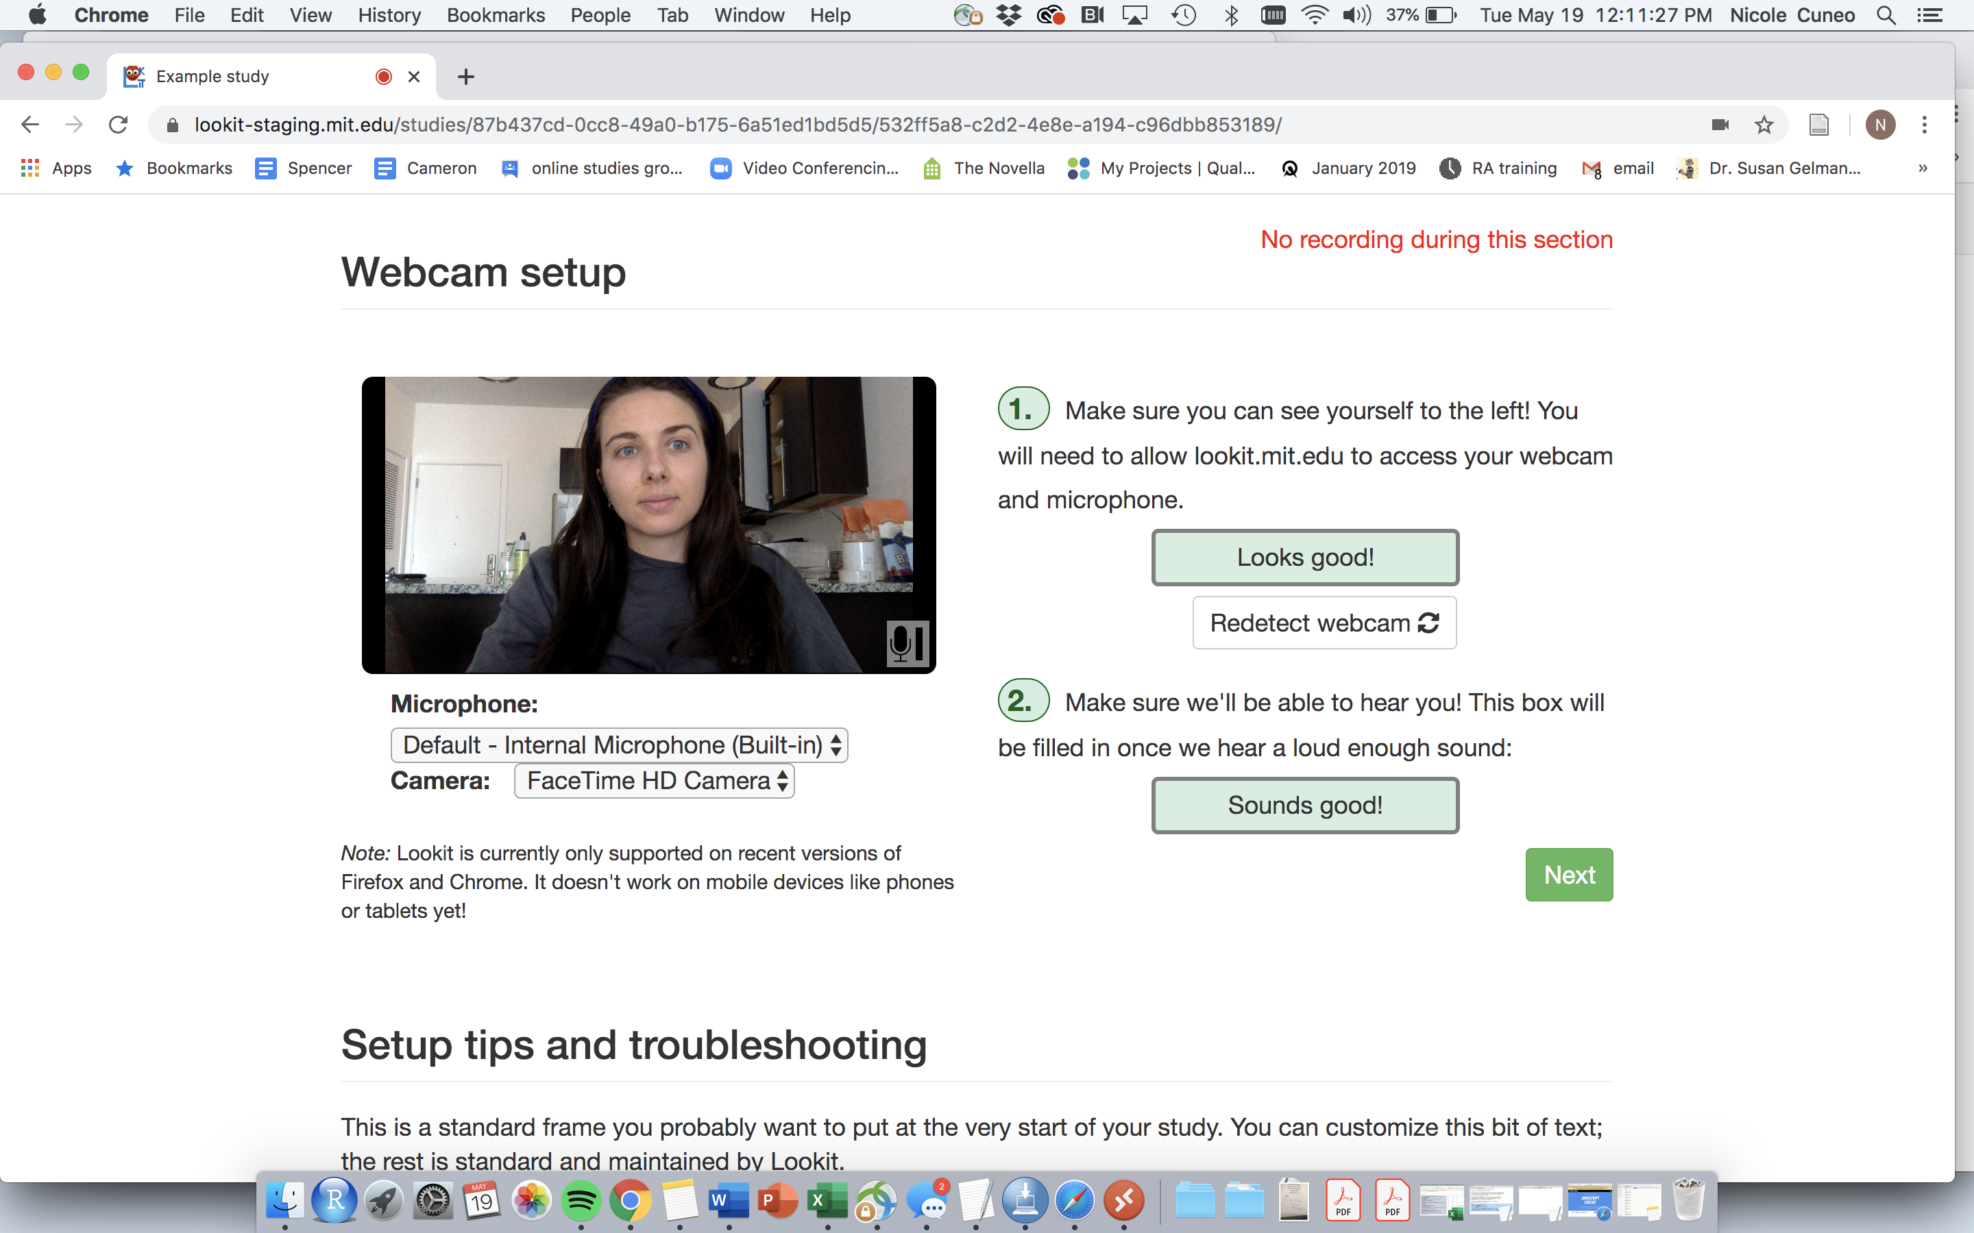
(Note: smiley face NOT included. Sparing you all my quarantine look)
The website pre-tests these things, to hopefully catch major issues

Slide 20
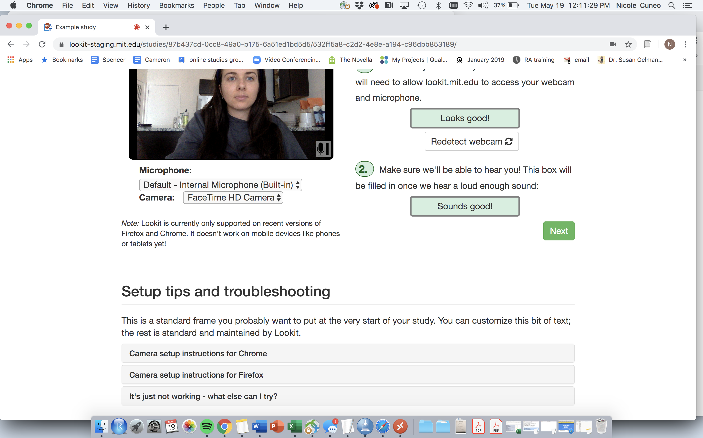
(Note: smiley face NOT included. Sparing you all my quarantine look)
Help and support

Slide 21
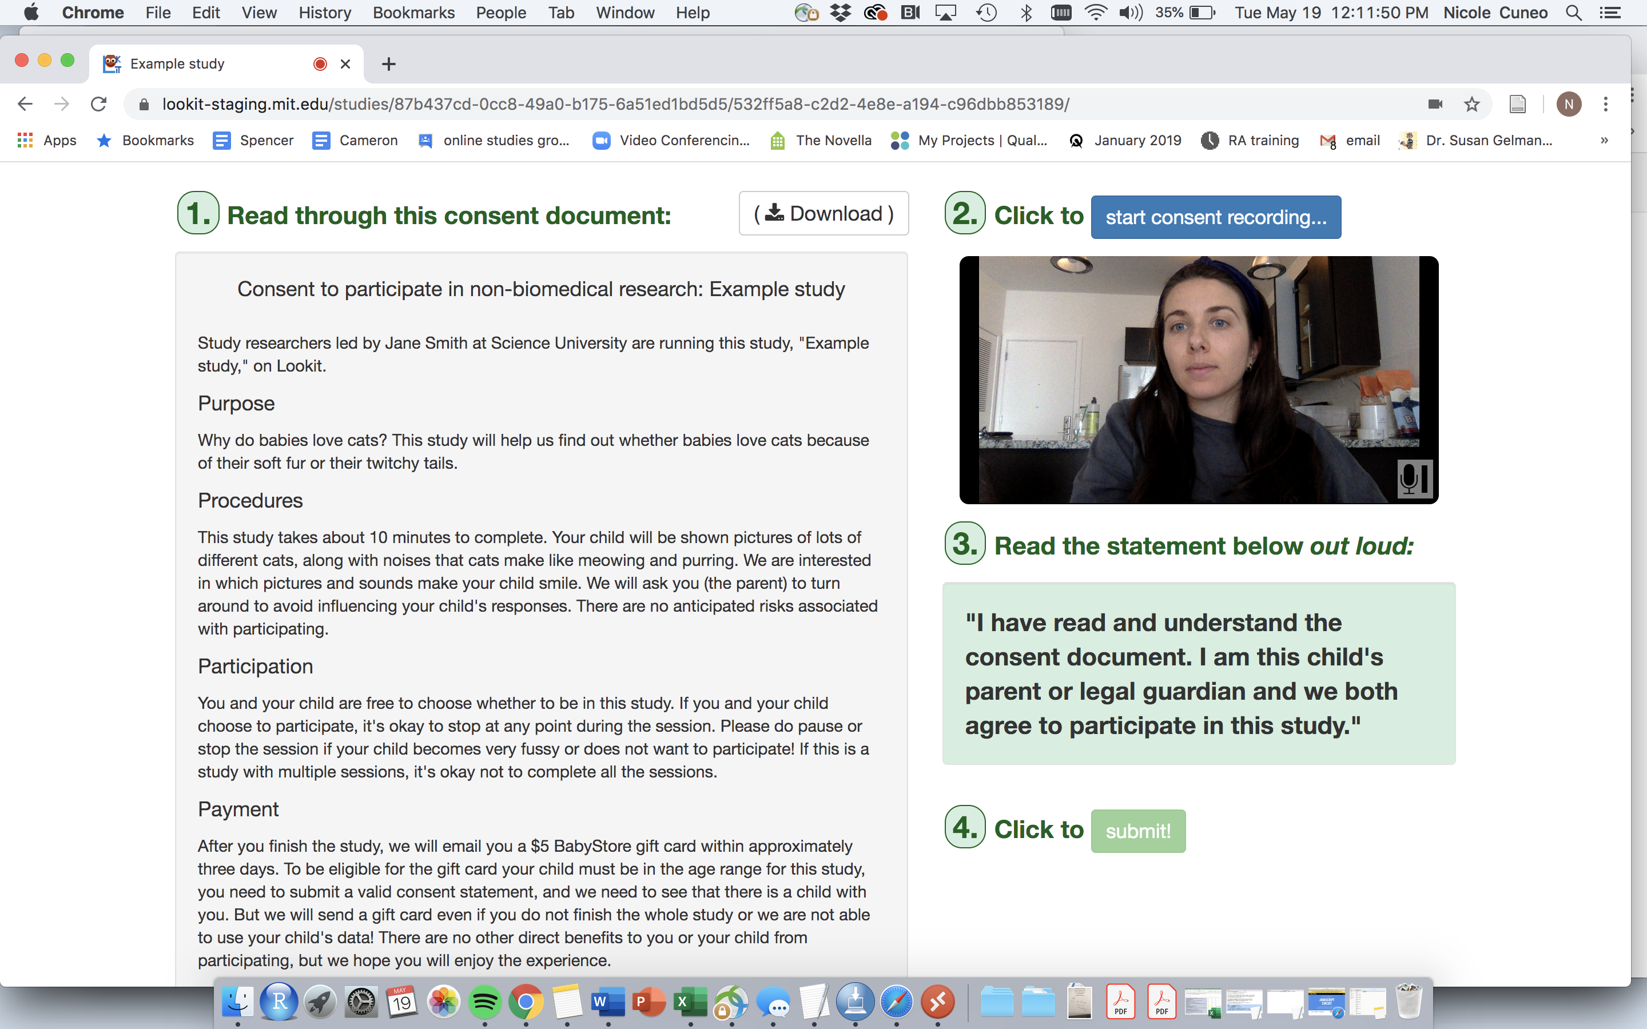
(Note: smiley face NOT included. Sparing you all my quarantine look)
This portion is customized (and IRB approved)
*Template sample found in the Lookit Github

Slide 22
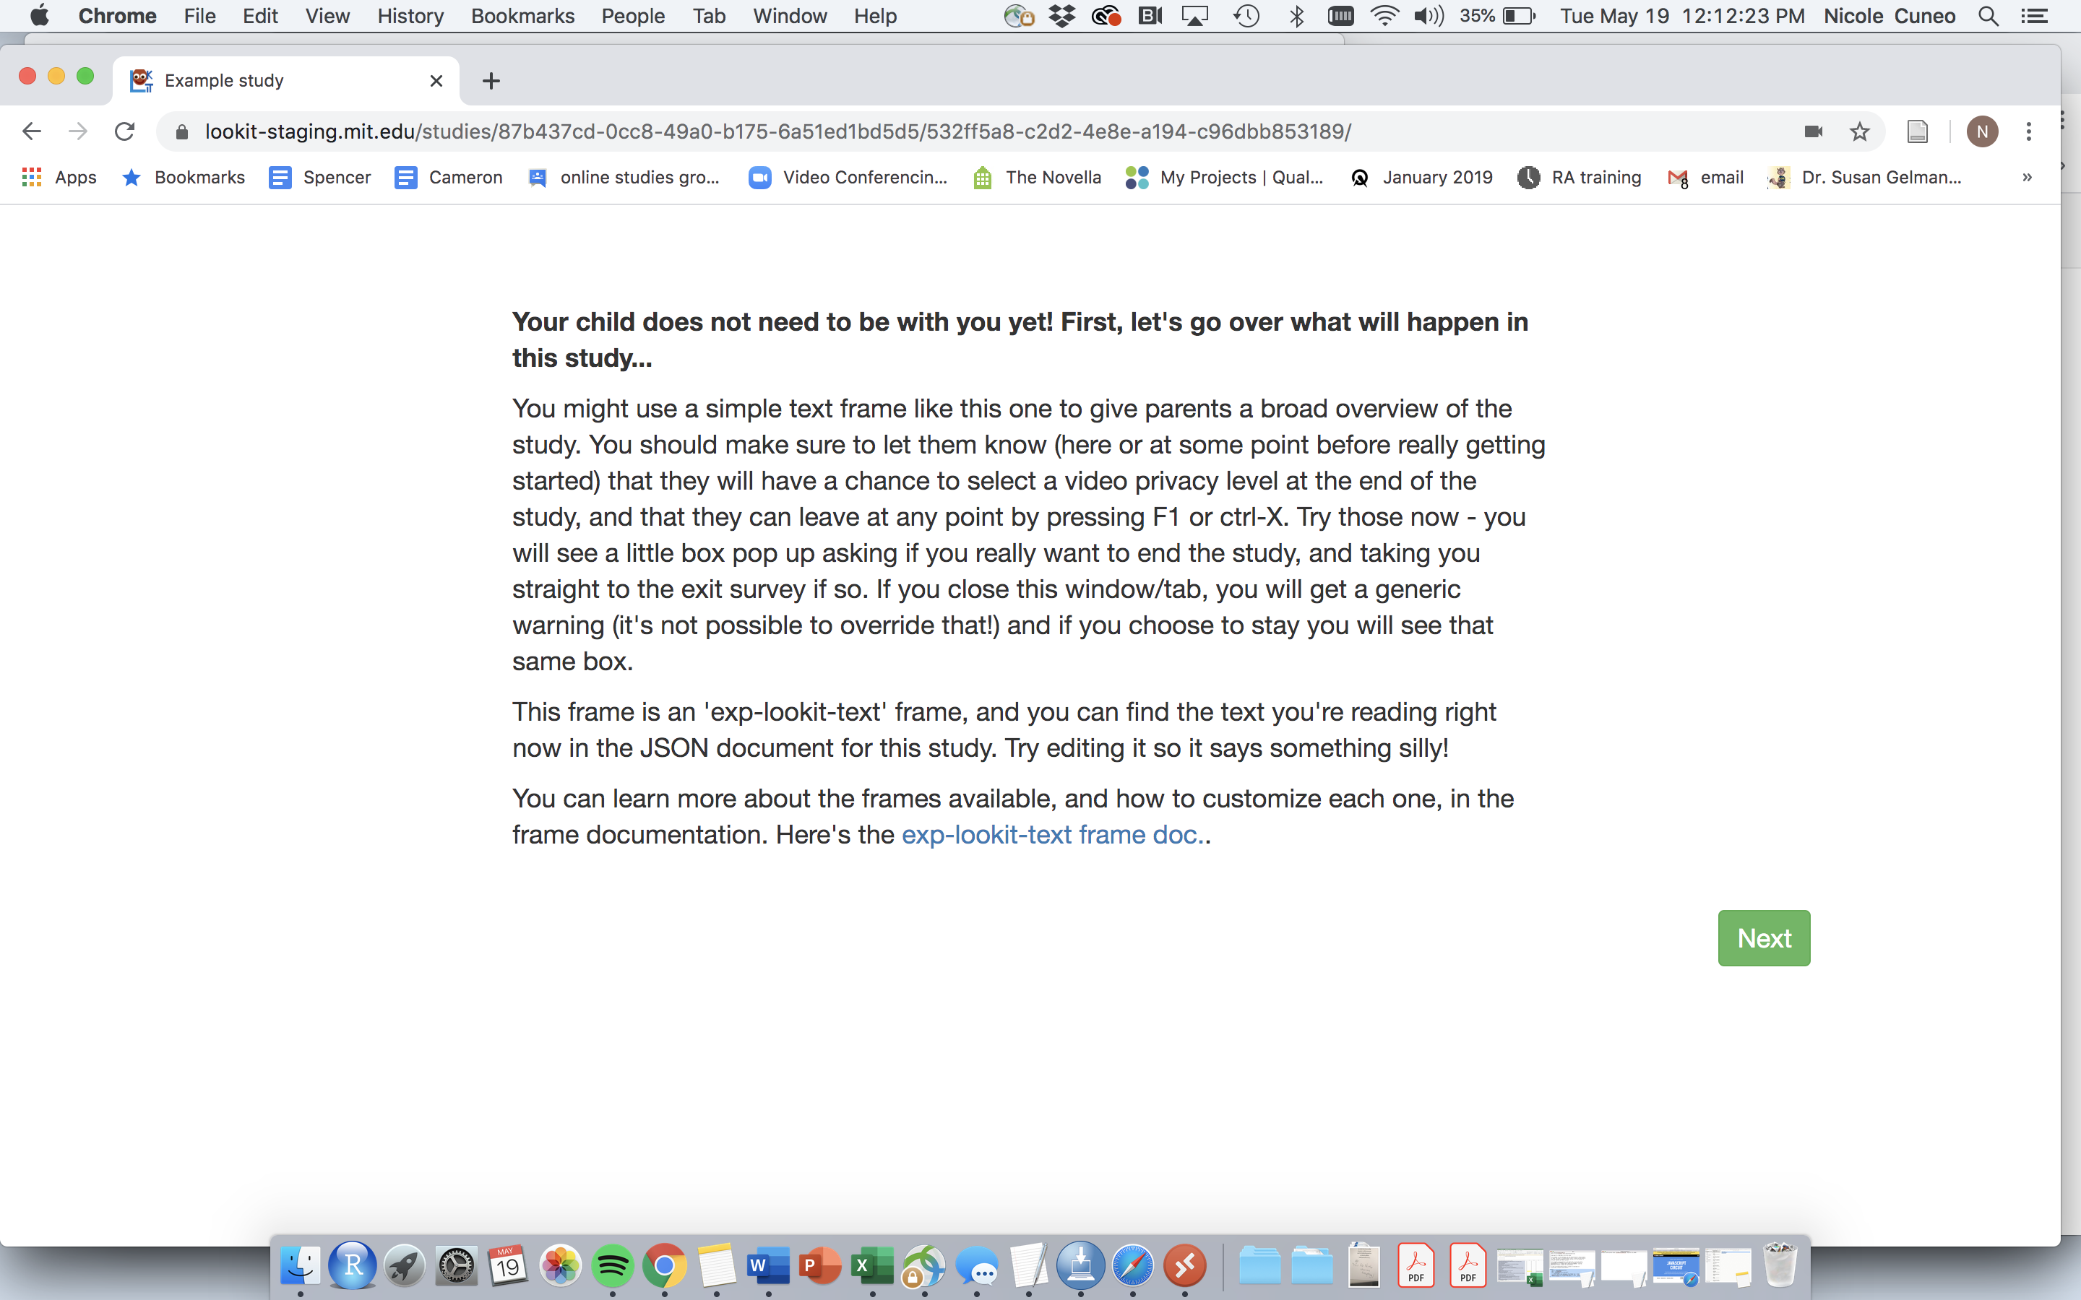
Pre-Study: Explaining

Slide 23
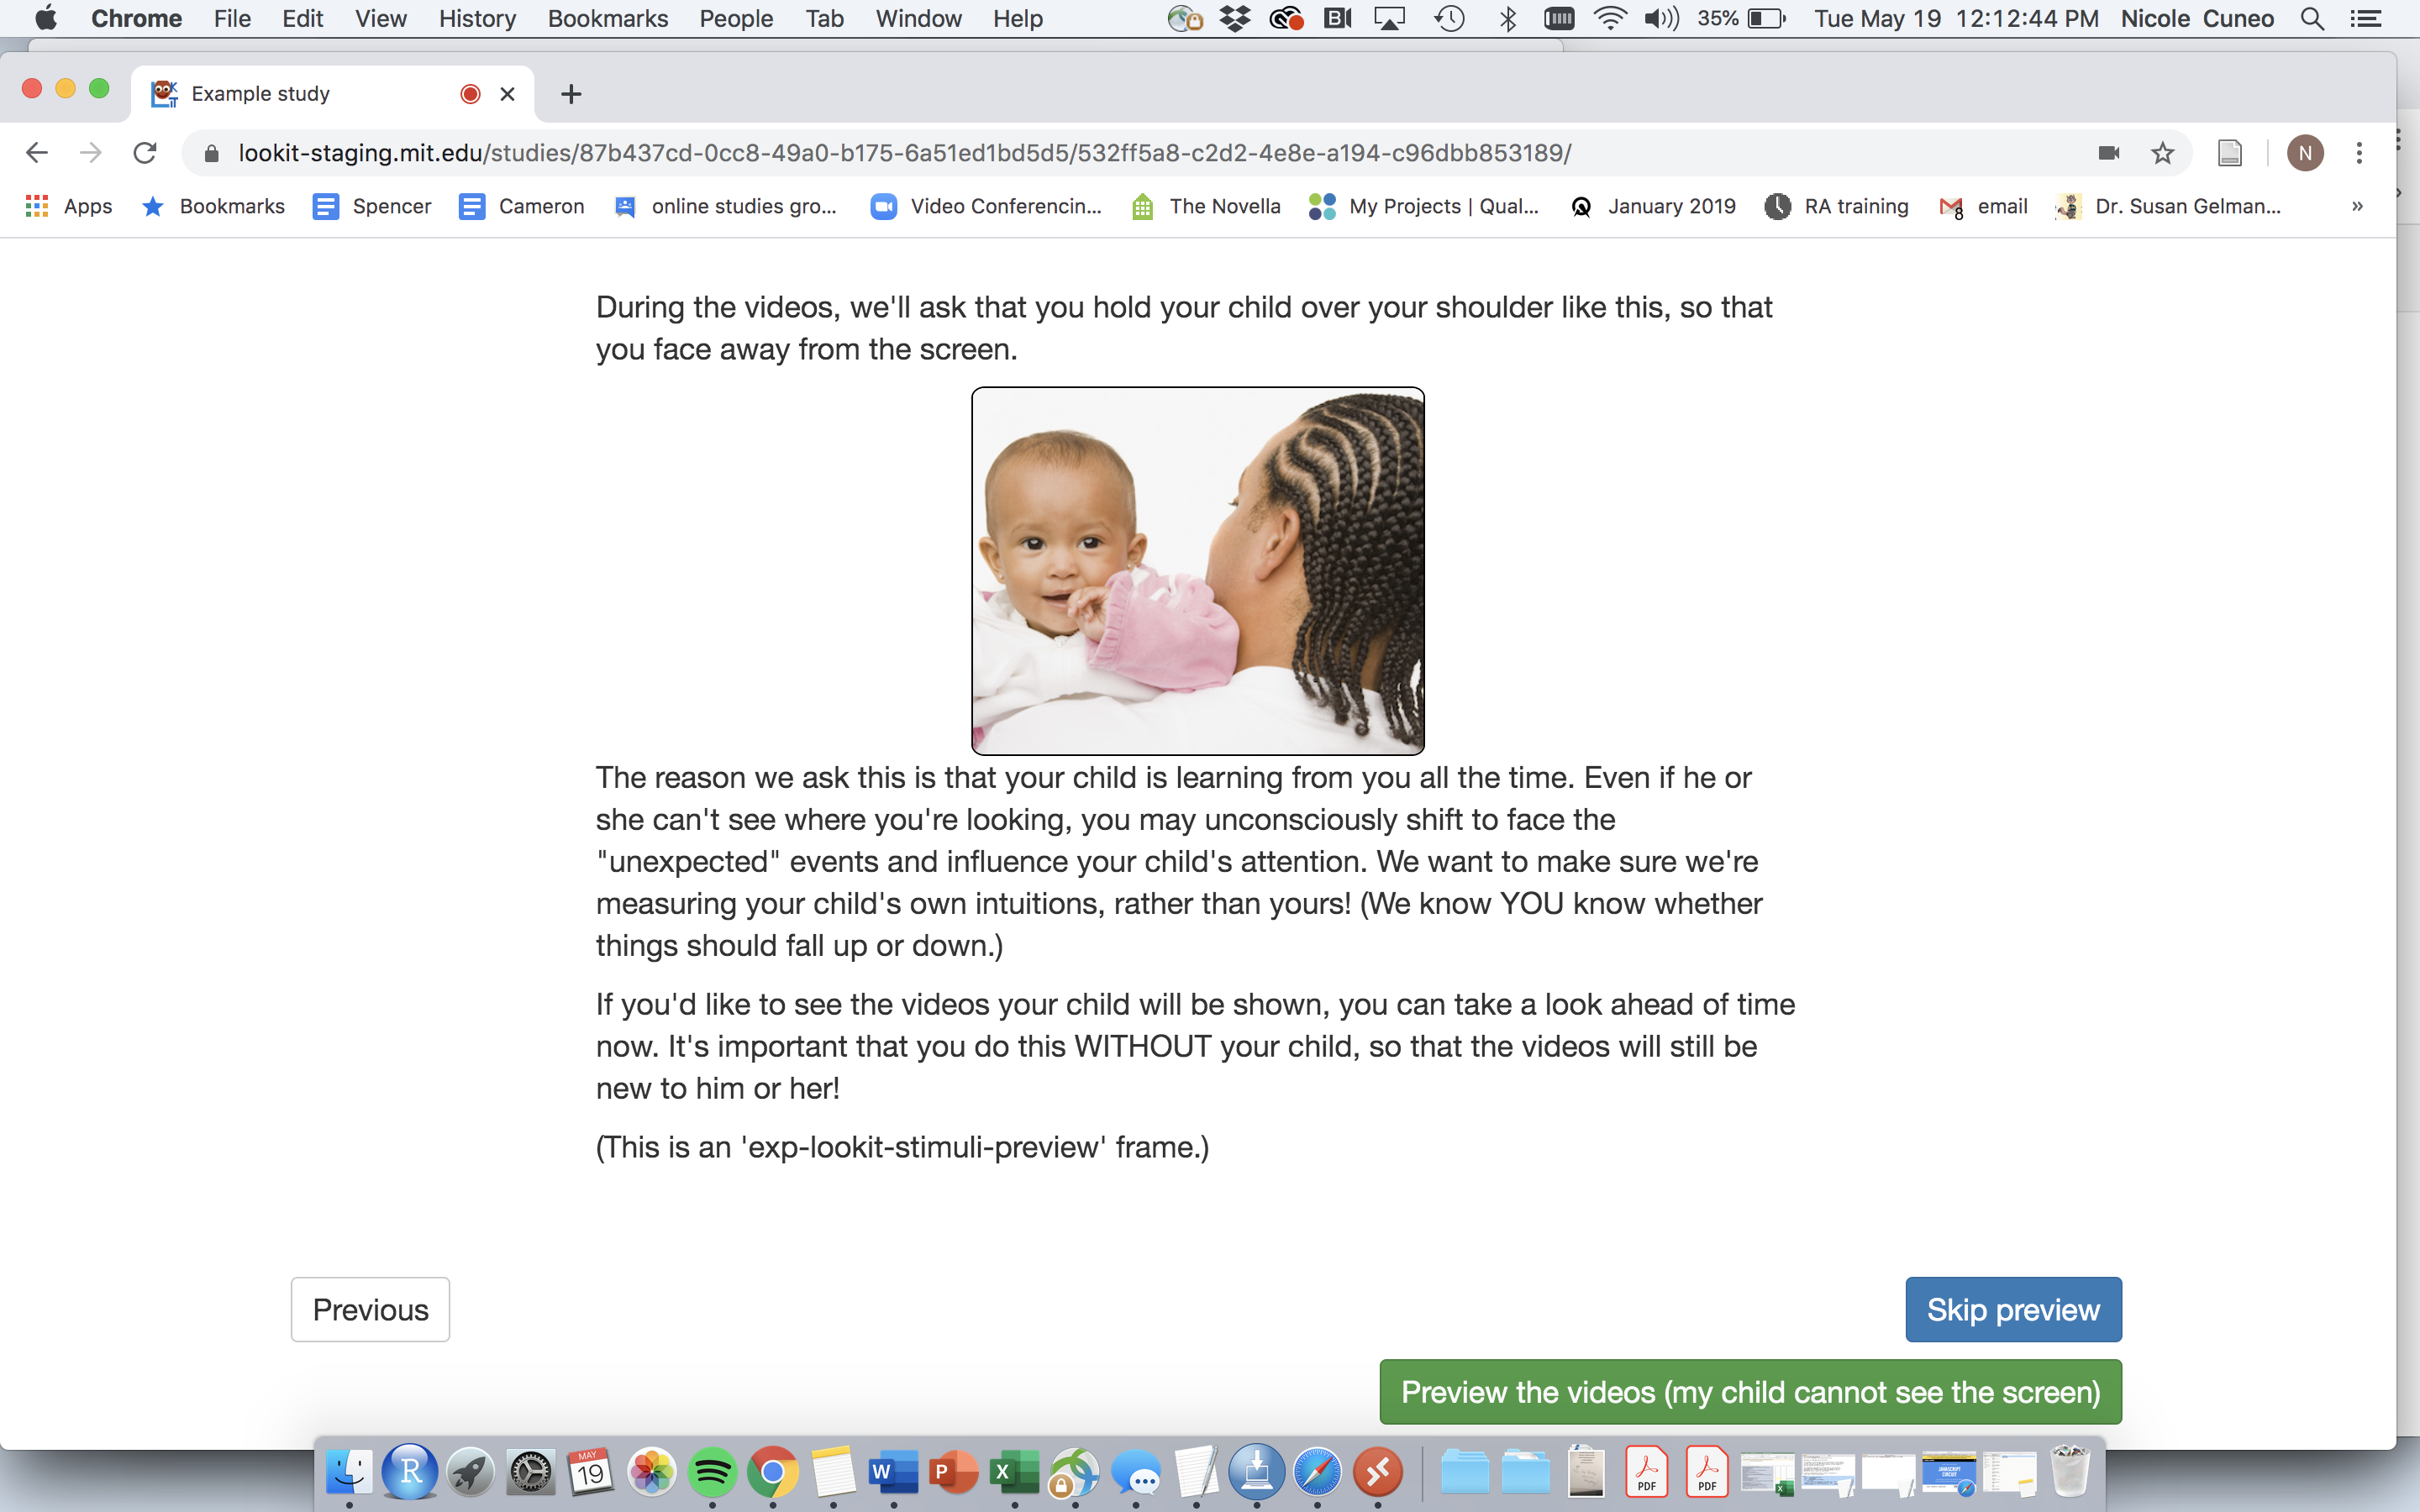
Pre-Study: Explaining
**Here is where we can add the high chair instructions
See next slide for the preview screen

Slide 24
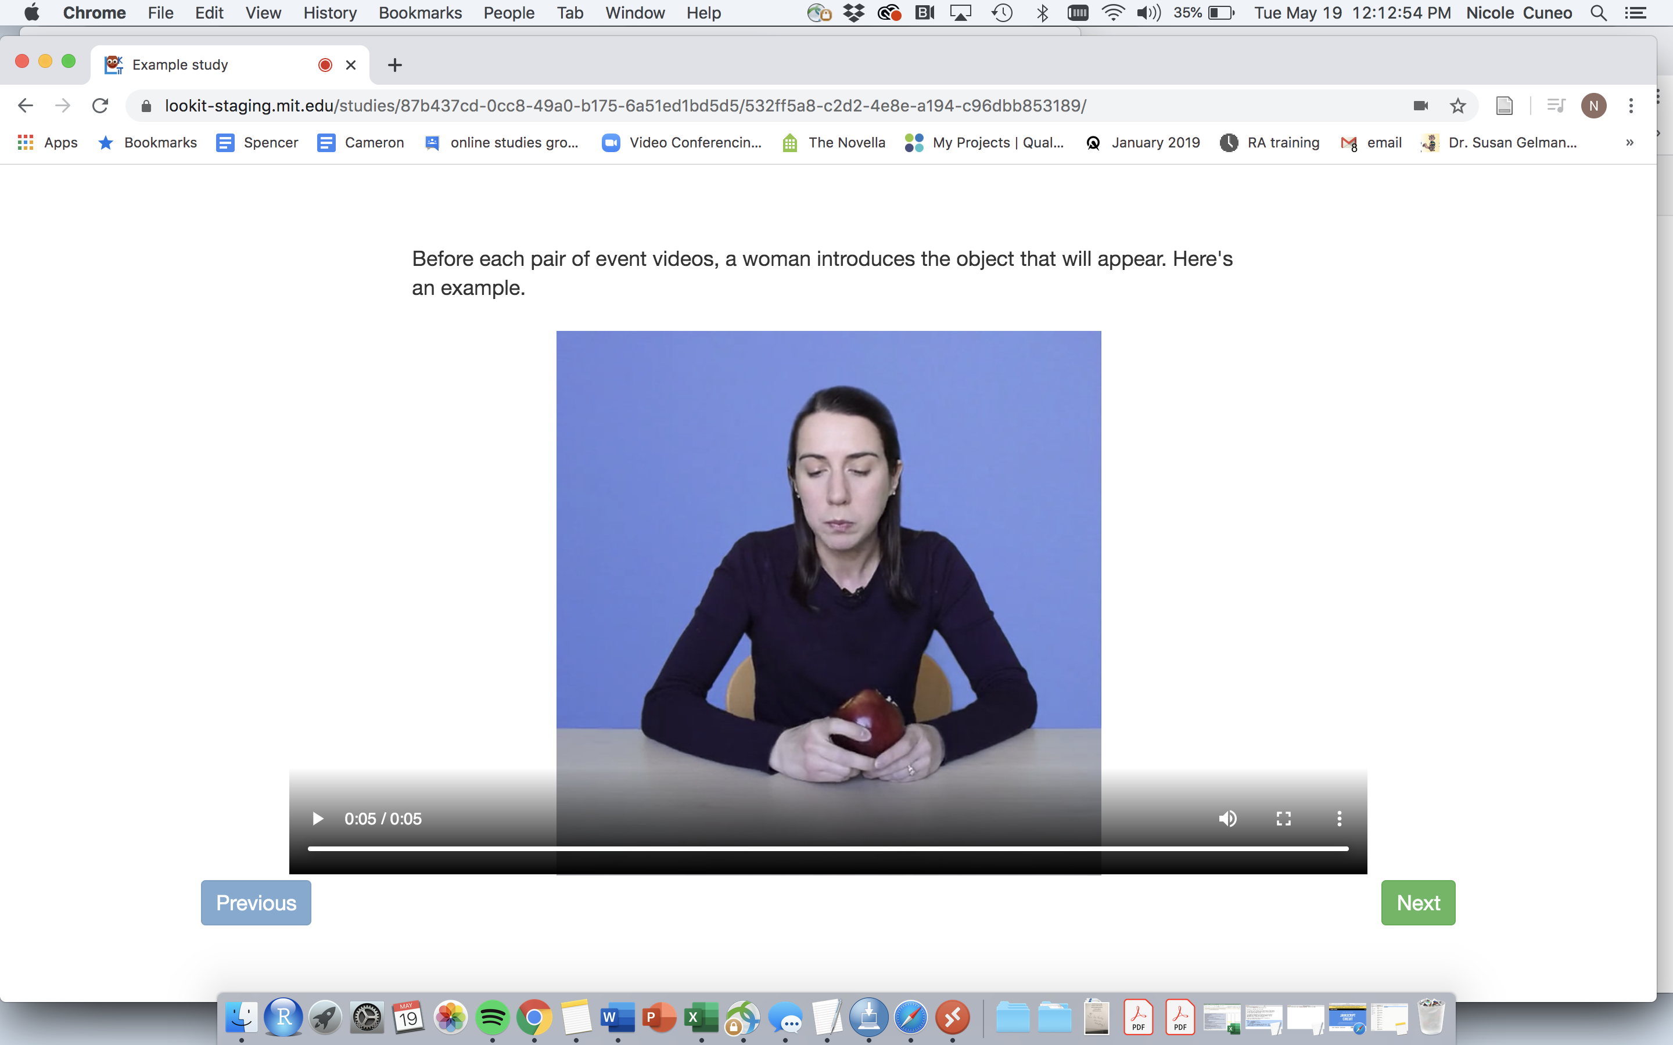
Pre-Study: Sample Video

Slide 25
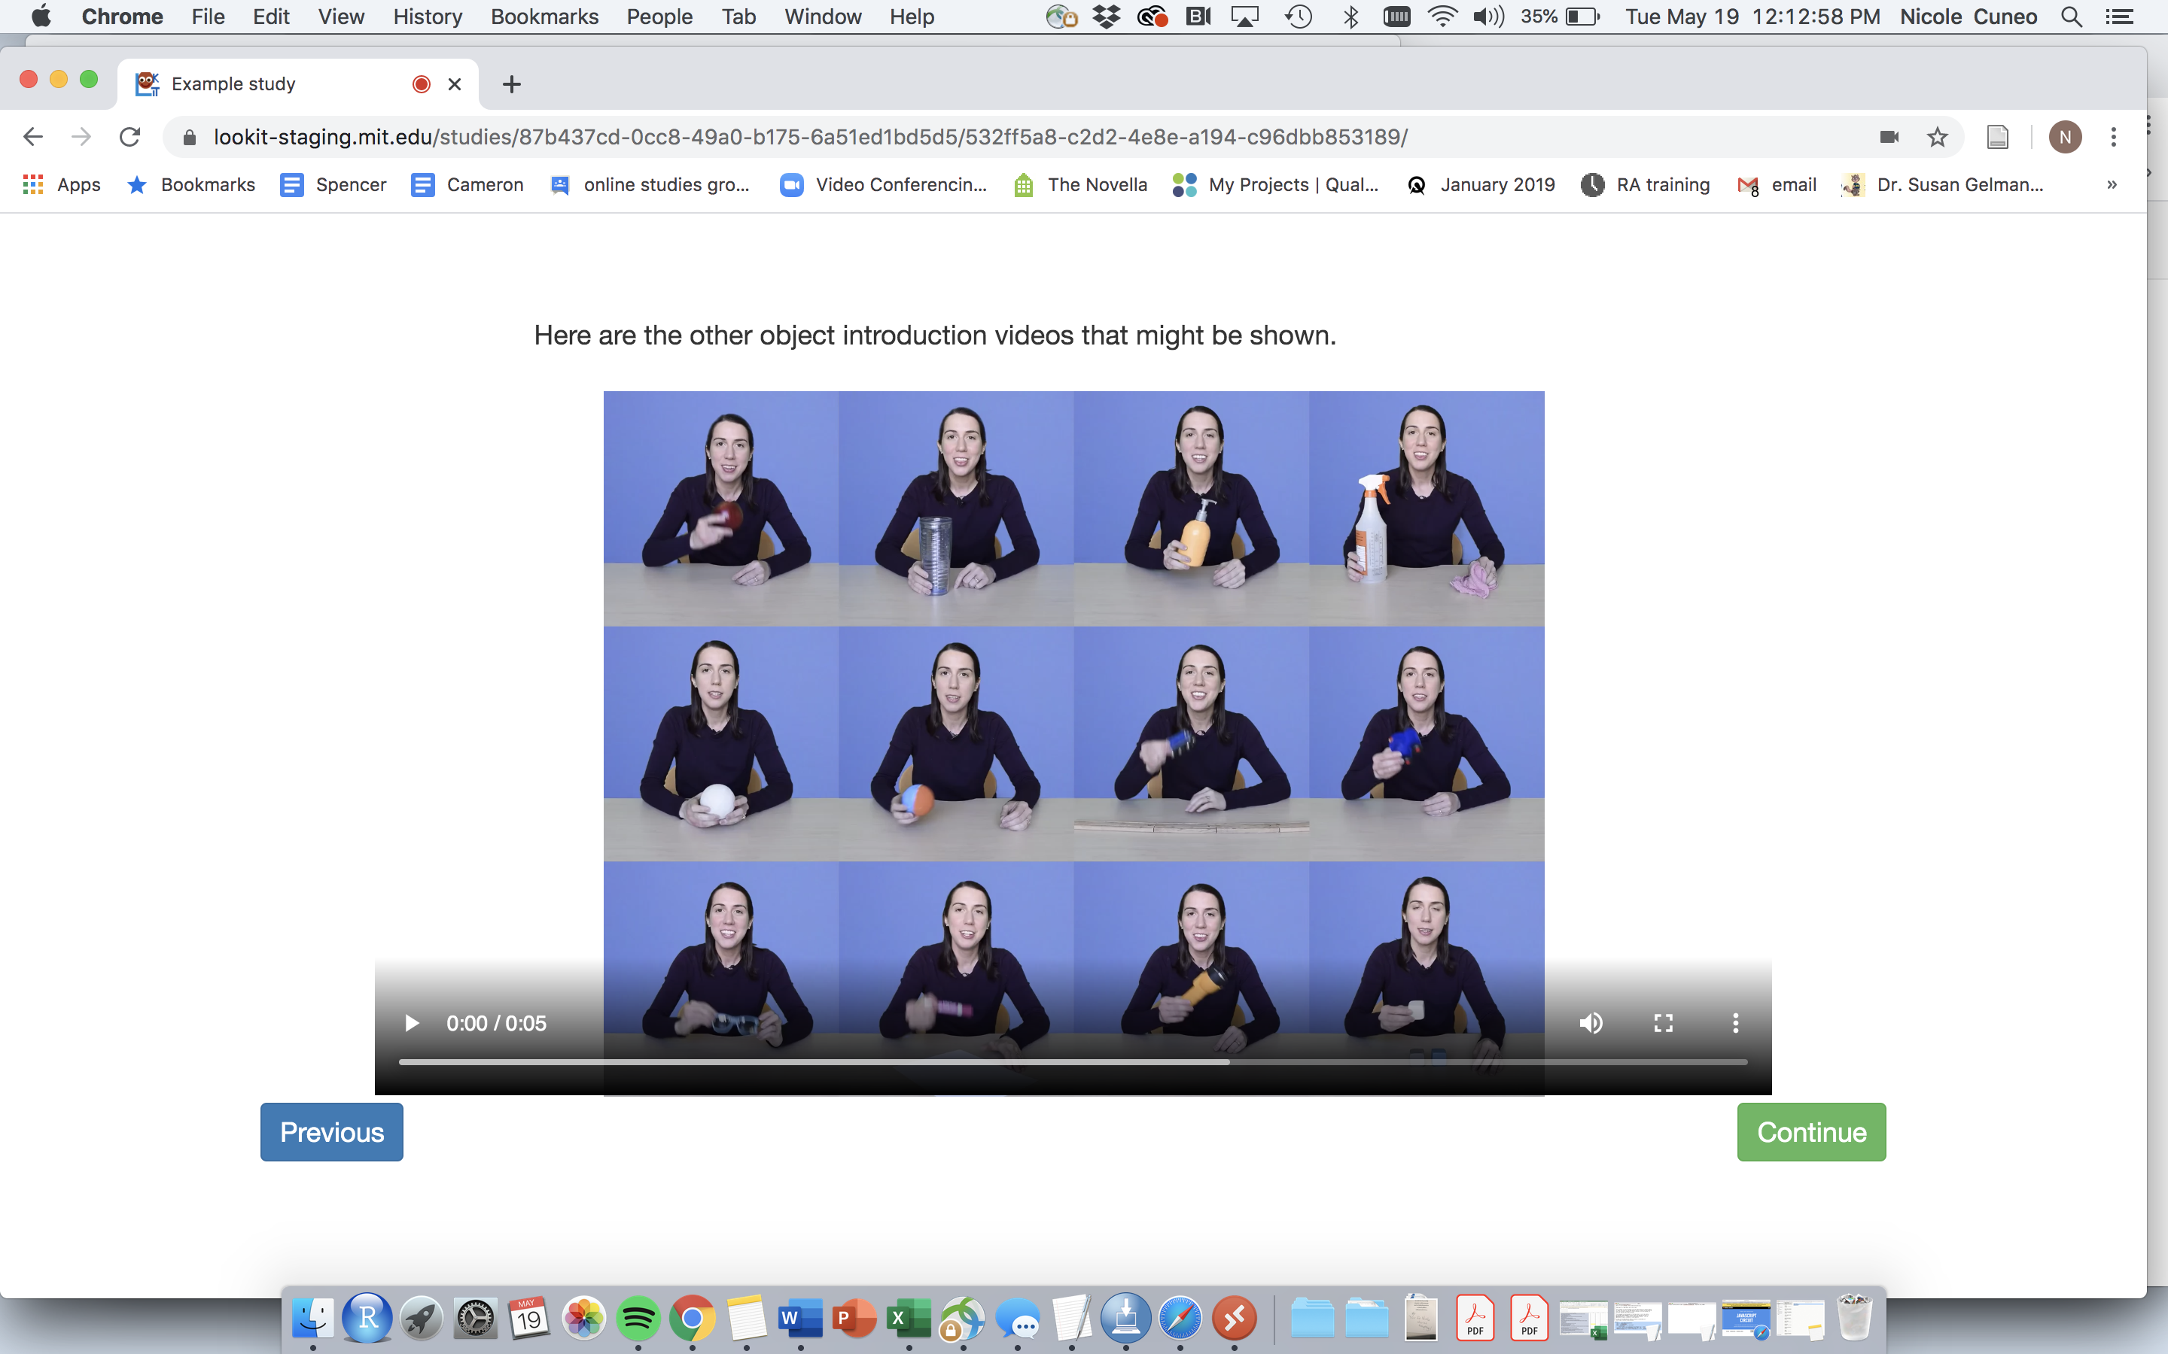
Pre-Study: Sample Video
**important if you have multiple conditions (can show multiple colors)

Slide 26
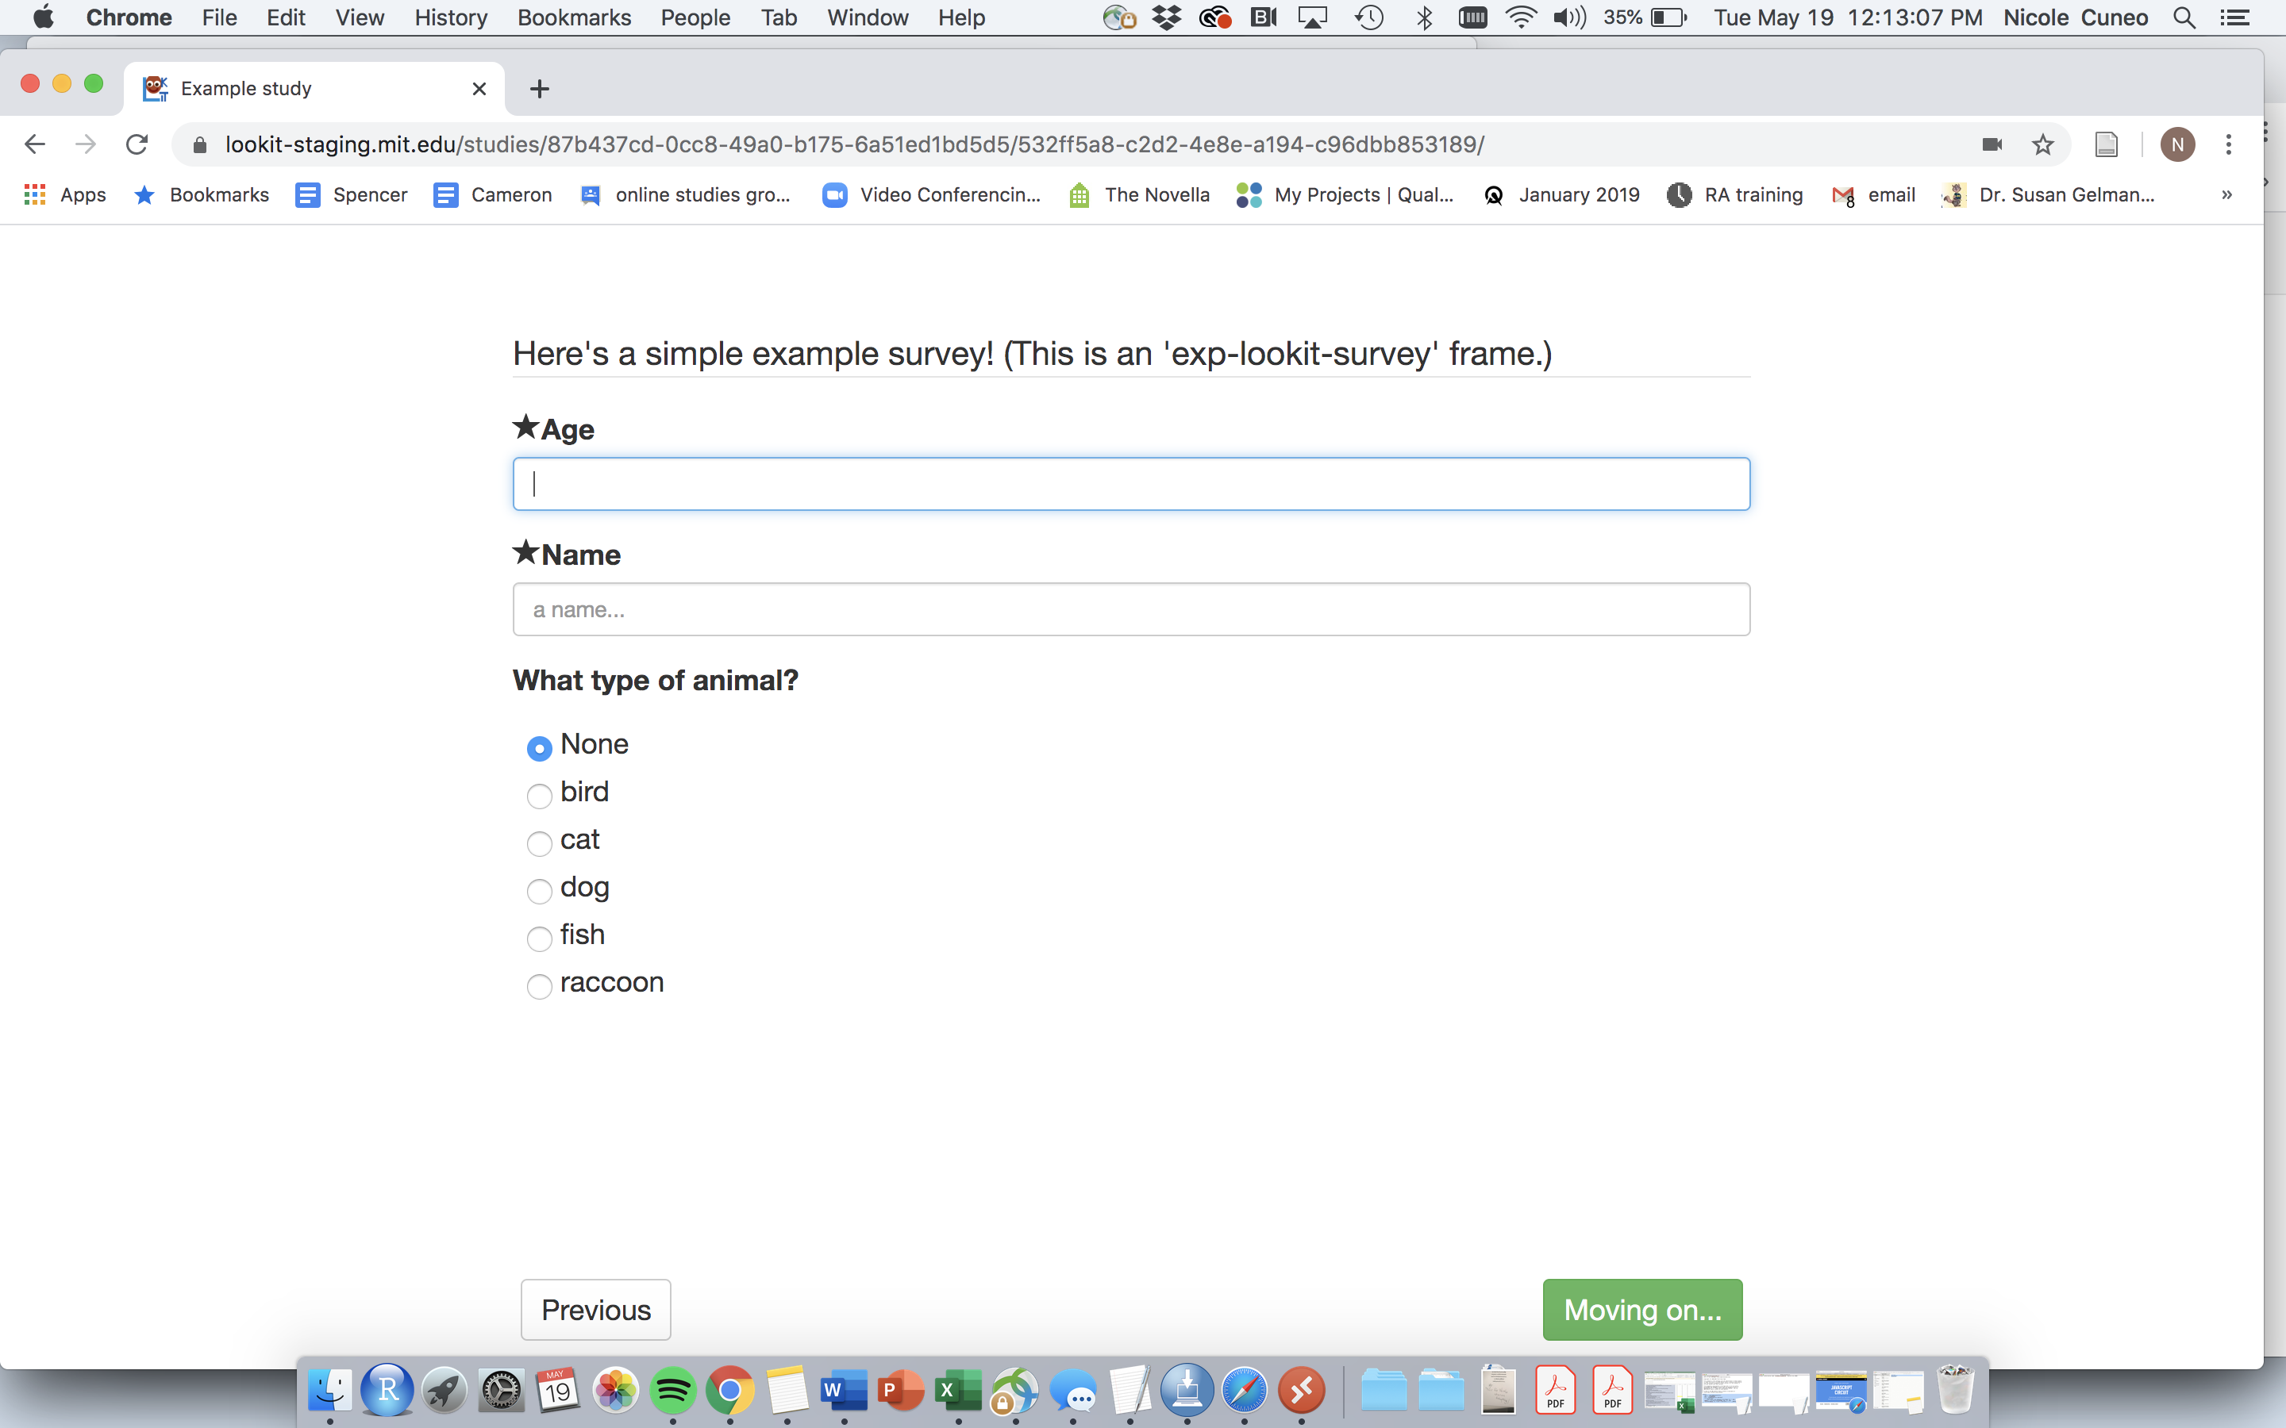
Pre-Study: Sample Video
If you need/would like to include survey questions

Slide 27
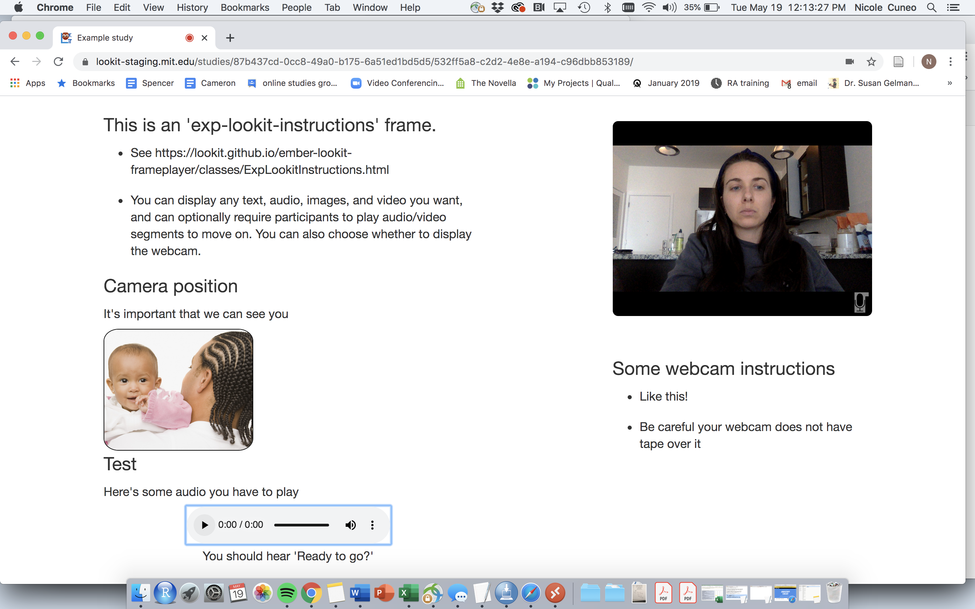
(Note: smiley face NOT included. Sparing you all my quarantine look)
Can add more instructions here!
Example: make sure the entire highchair back is on the camera

Slide 28
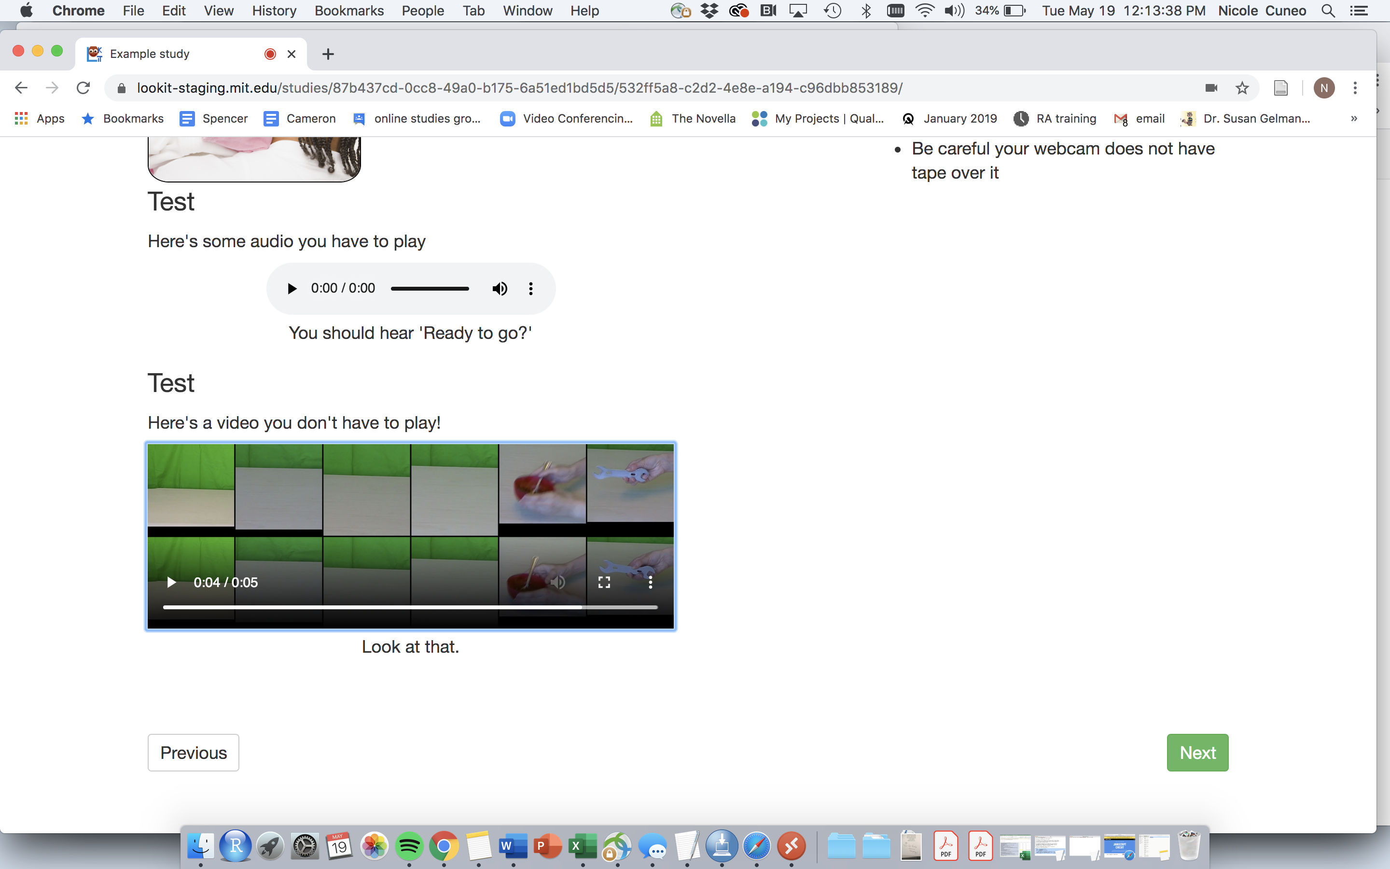
To test the videos work (pre-testing)

Slide 29
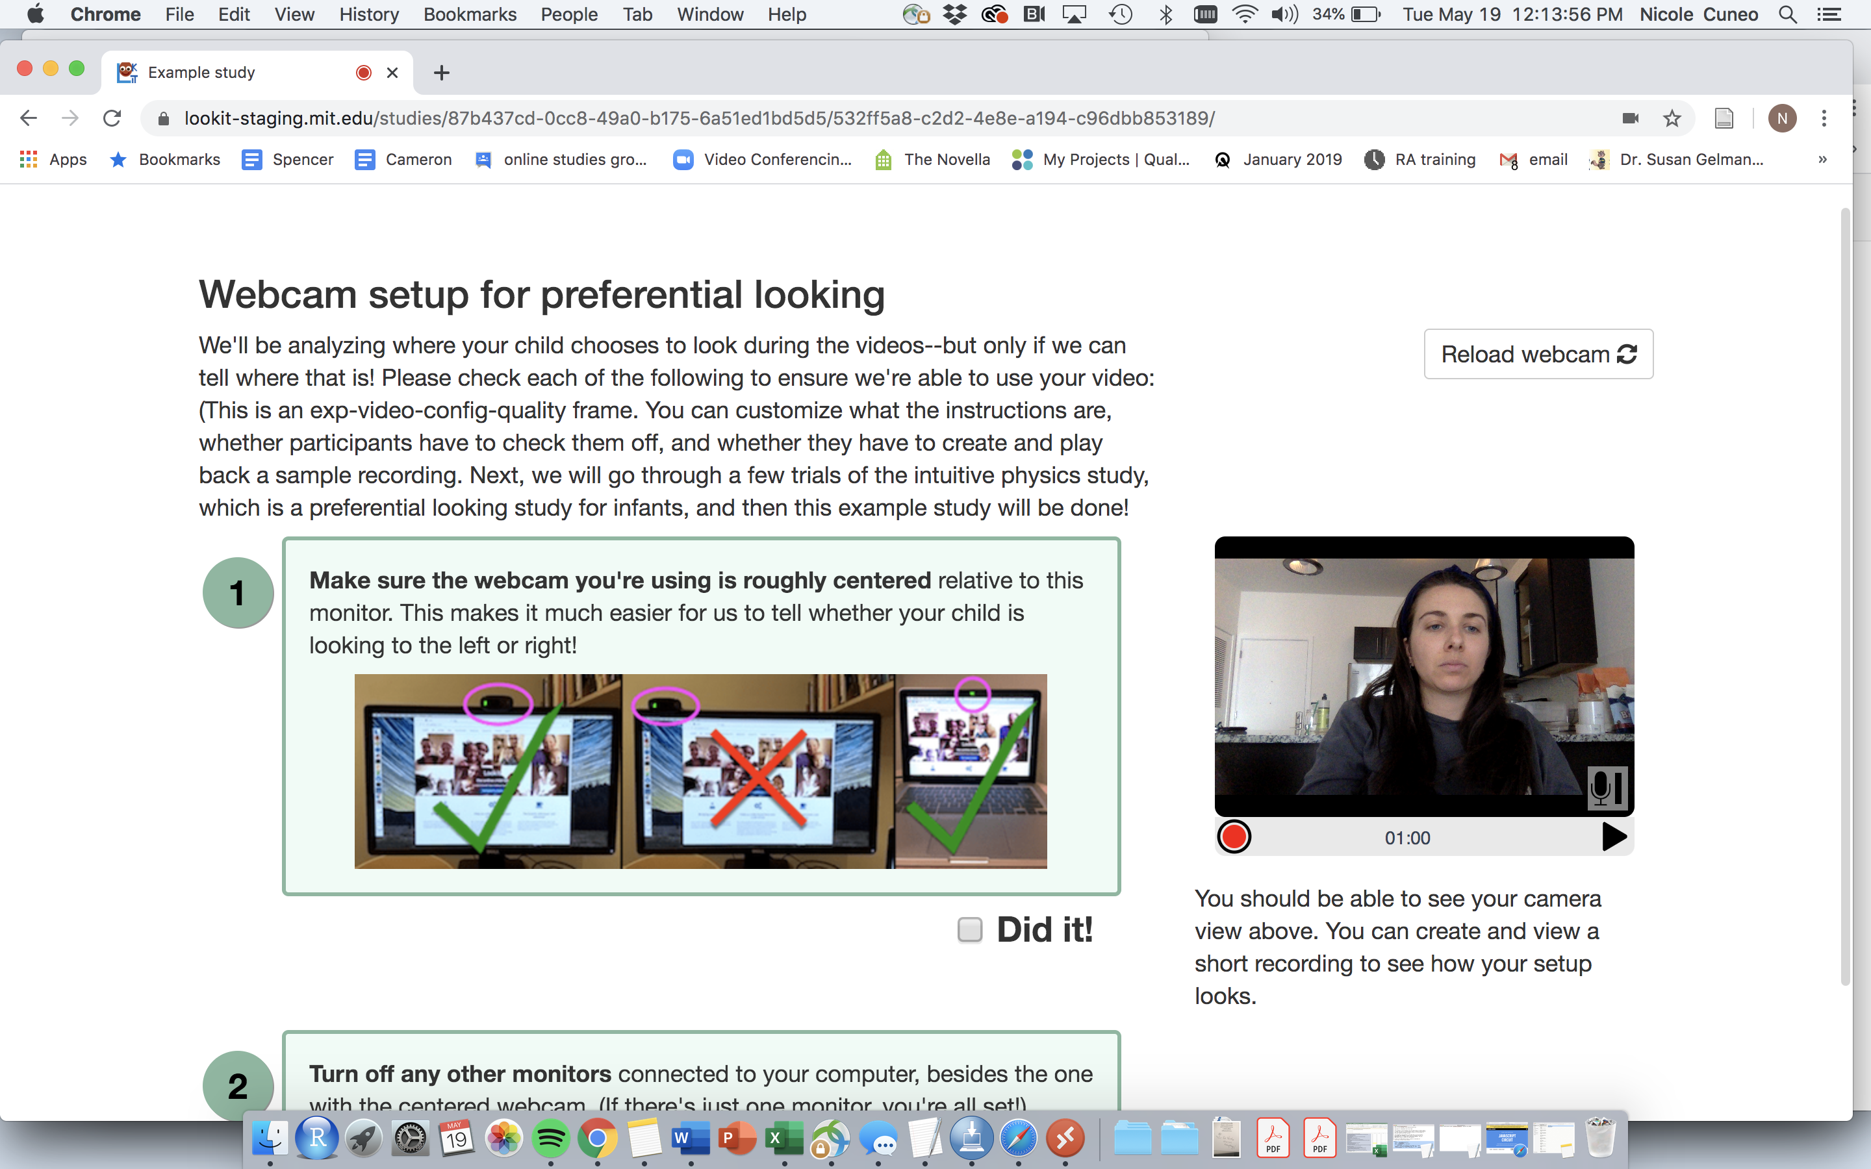
(Note: smiley face NOT included. Sparing you all my quarantine look)
Must check this box BFEORE moving on (won’t allow “Next” if not)

Slide 30
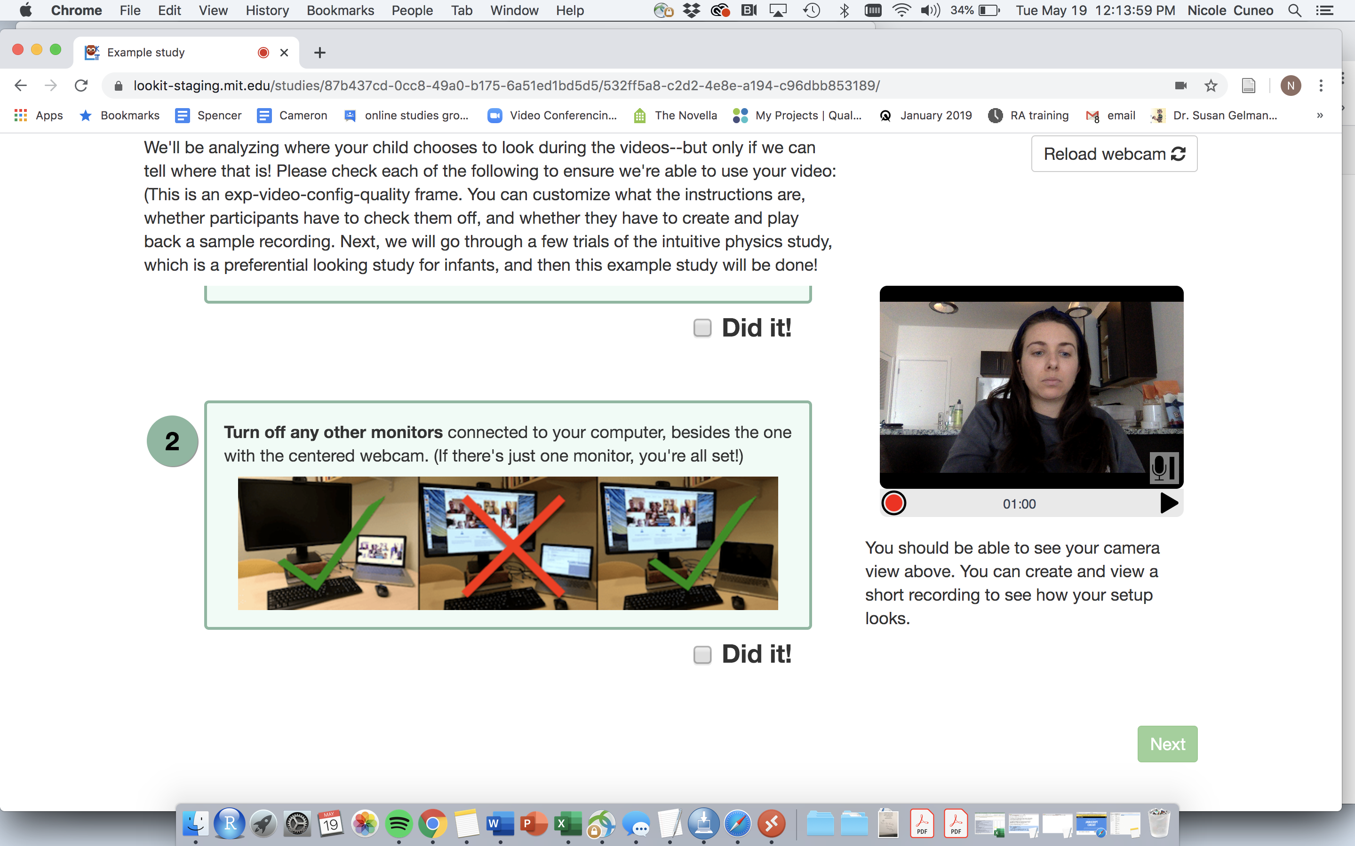
(Note: smiley face NOT included. Sparing you all my quarantine look)
Must check this box BFEORE moving on (won’t allow “Next” if not)
(Looks like this until you check the boxes)

Slide 31
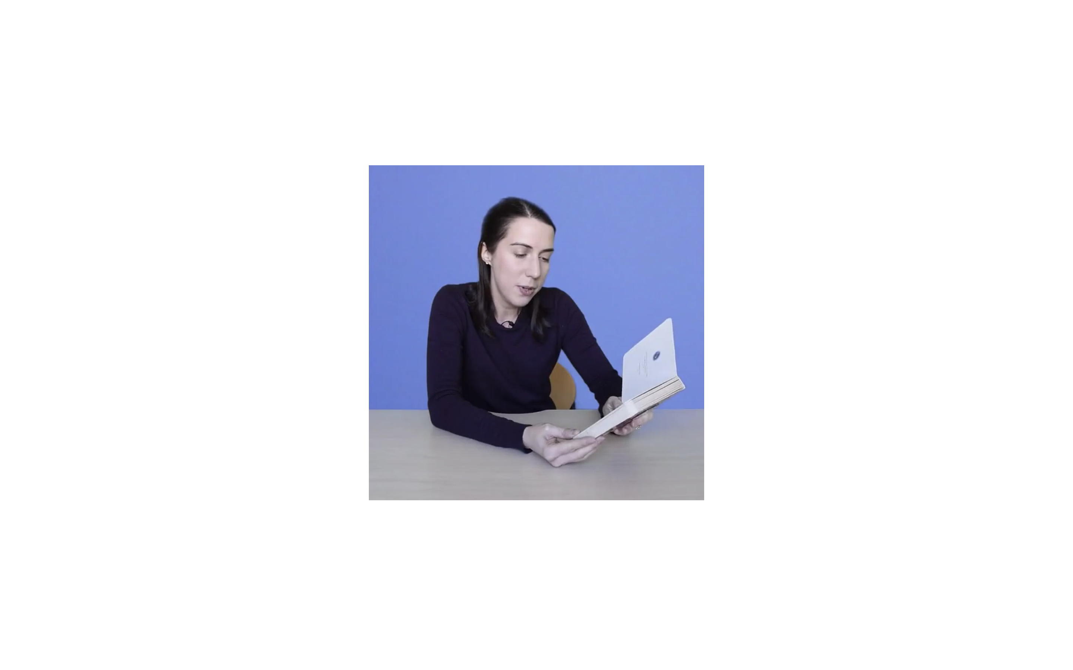
Sample experiment
Note:
-white background
-full screen (the code switched to this automatically)
-as a “parent” I have to do nothing

Slide 32
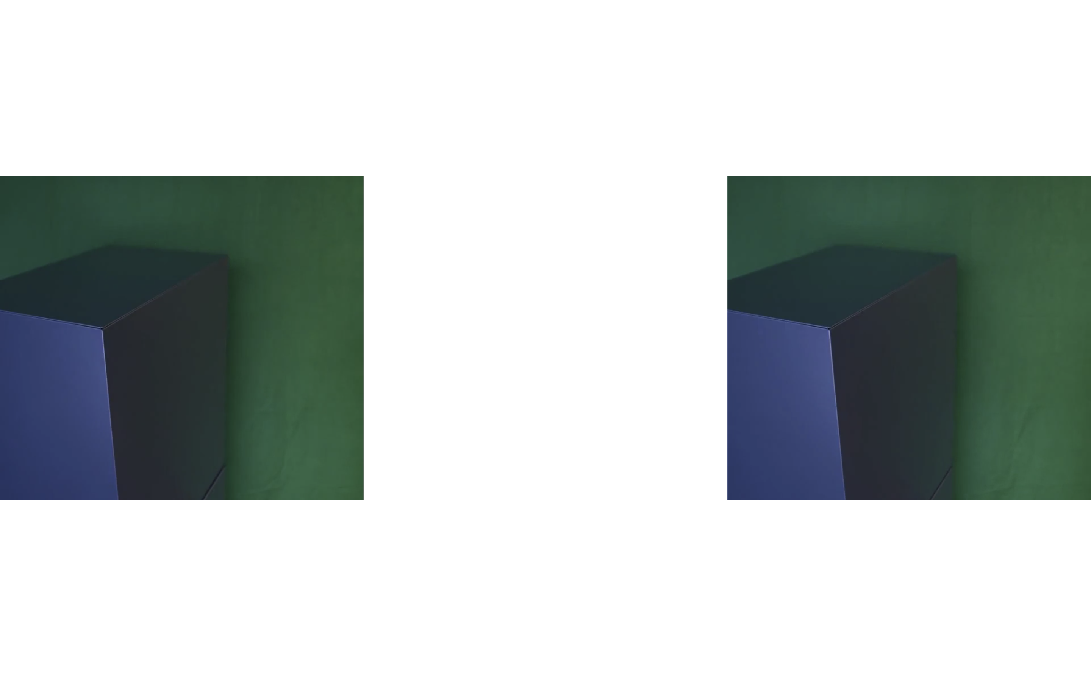
Sample experiment
Note:
-white background
-sample paired preference paradigm
-full screen

Slide 33
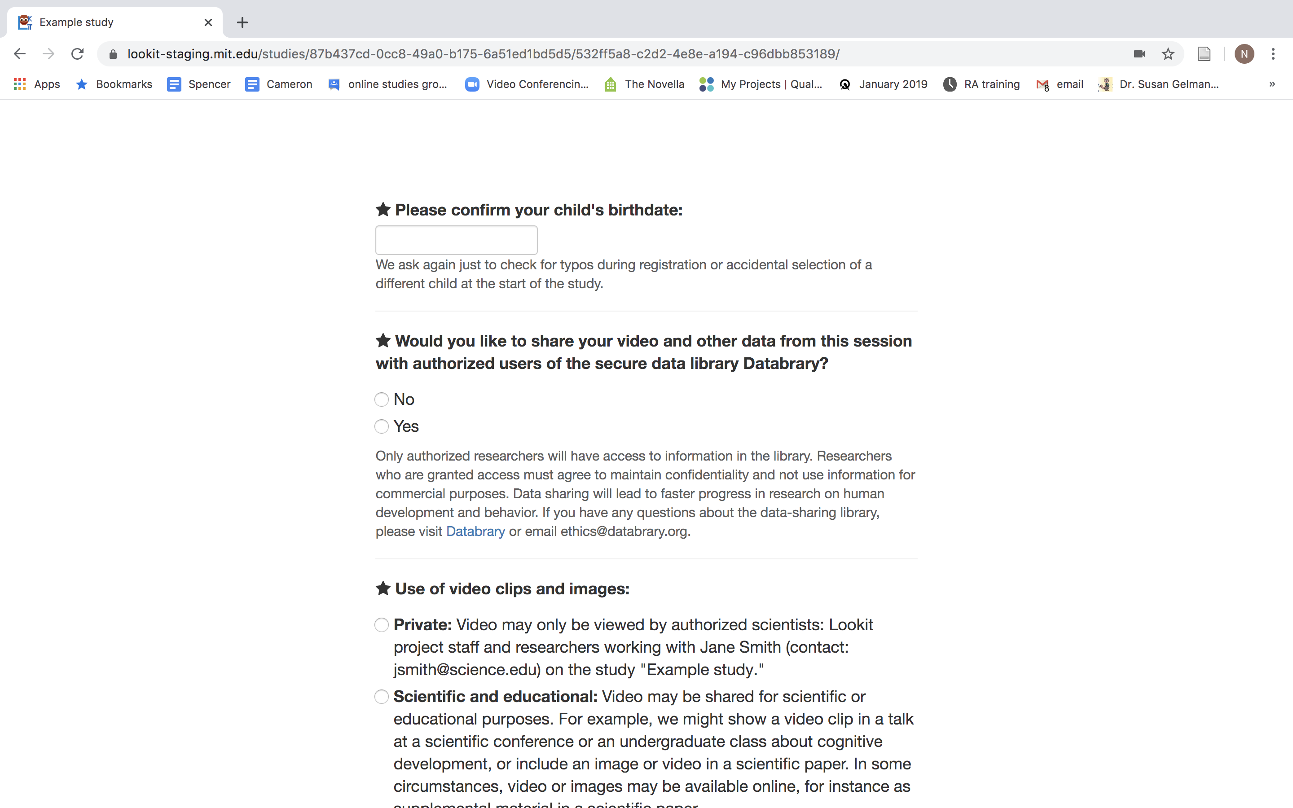
POST Study Questions
Note: as per Kim Scott’s 2017 paper
-less than 1% decided not to upload their video at then end

Slide 34
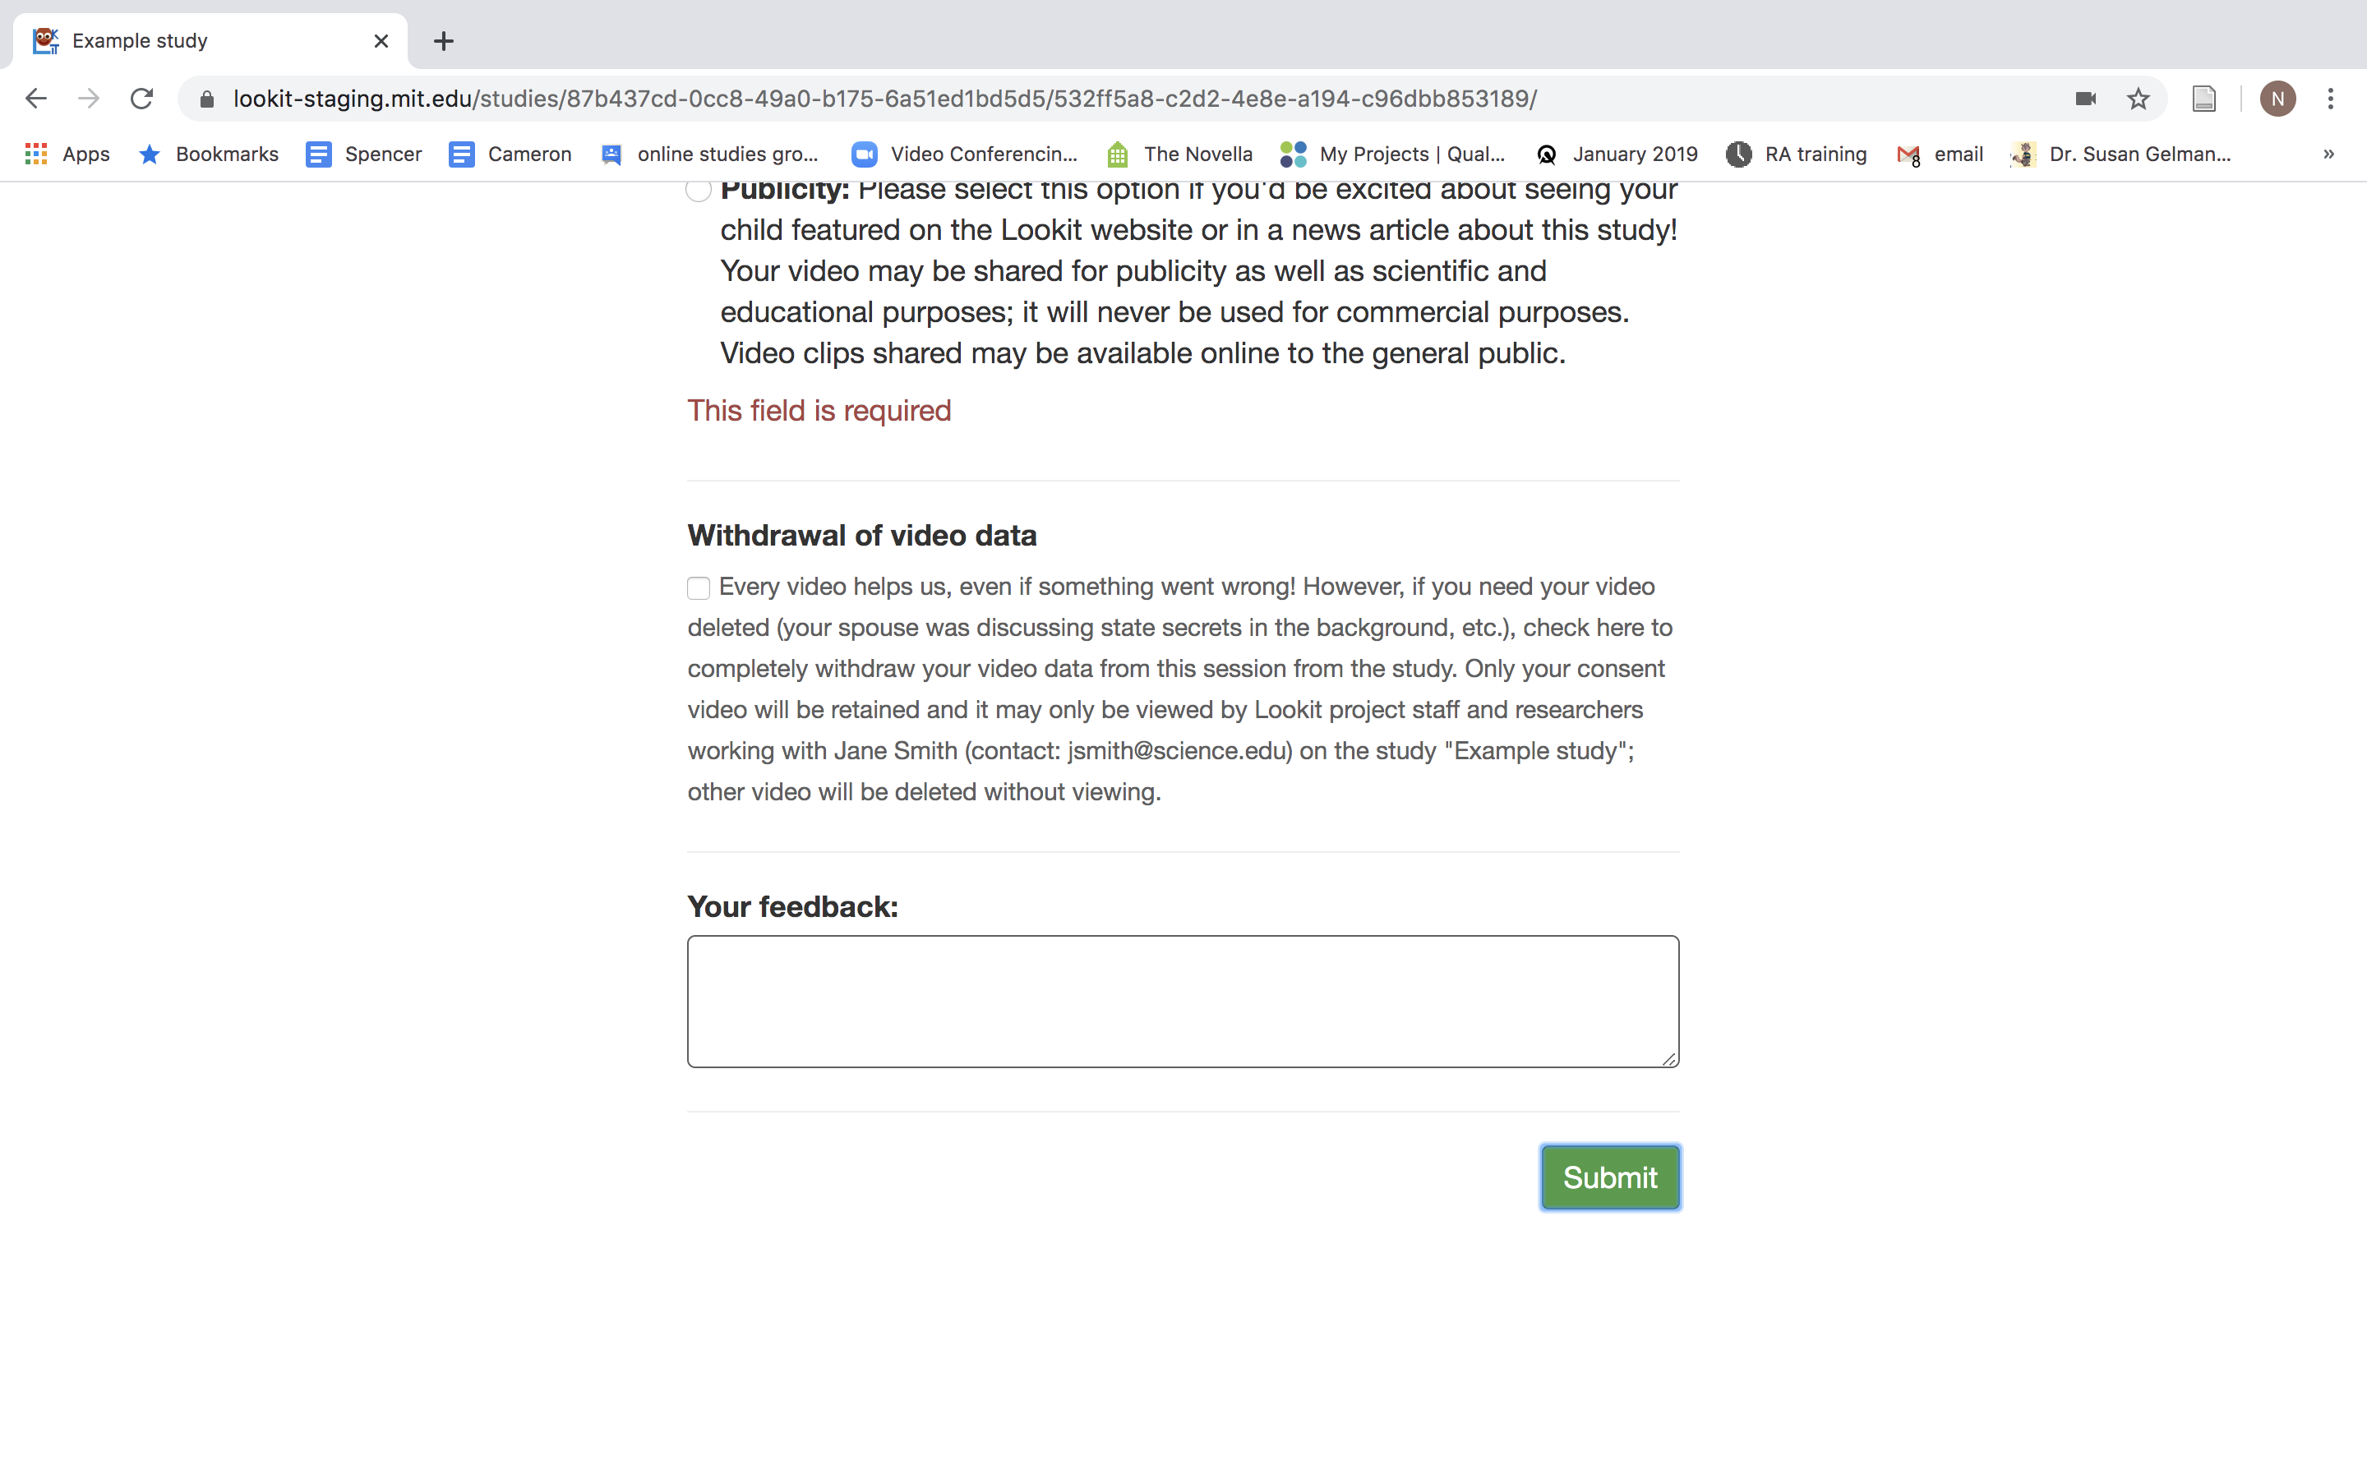
POST Study Questions
Note: as per Kim Scott’s 2017 paper
-less than 1% decided not to upload their video at then end

Slide 35
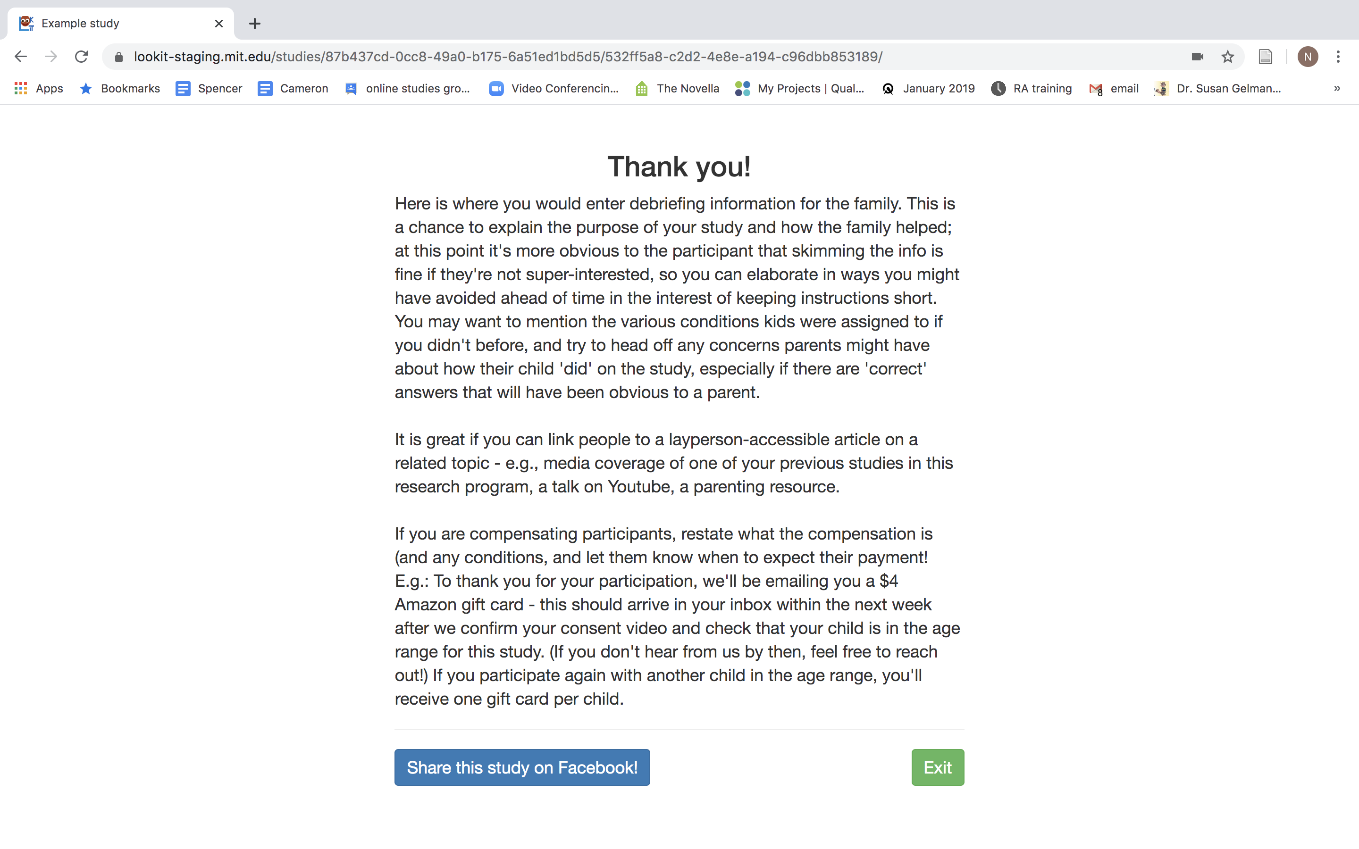
Family Debriefing Information

Slide 36
To Do List:
ADMINISTRATIVE
CODE RELATED
Pick study picture
Pick study name
Make consent form (using Github template) **must be approved by IRB
Study set up instructions page (for video)
Sample stimuli for parents (pre study)
Debriefing form
Complete training class (on Lookit)
Create stimuli/study materials
Create code (re: Github)

